Slide 1
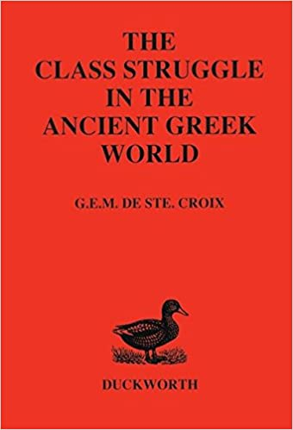
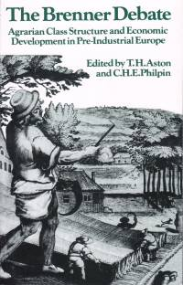
Session 5: Controversies and relevance
History as class struggle
“The specific economic form, in which unpaid surplus labour is pumped out of direct producers, determines the relationship of rulers and ruled, as it grows directly out of production itself and, in turn, reacts upon it as a determining element. Upon this, however, is founded the entire formation of the economic community which grows up out of the production relations themselves, thereby simultaneously its specific political form.”
Marx (1865) Capital, Volume 3. MECW 37: 777-78

Slide 2
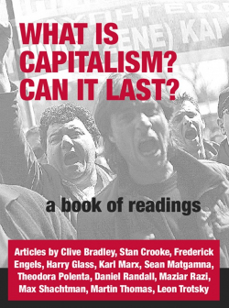
Global capitalism
“There are four developments which are relatively new in the last 10 years or so. The first is that we have a world made up almost entirely of capitalist states integrated into the world market...
“Secondly, almost all countries are integrated into the world market in complex ways. They include substantial sectors integrated into complex production networks stretching over several countries...
“Thirdly, there has been an enormous cheapening and speeding-up of transport and communications. Almost anything that can be traded, can be traded internationally…
“Fourthly, the wage-working class… is probably the majority of the world's population for the first time ever.”
Martin Thomas, Capital writ large, Workers’ Liberty 63, July, 2000: 7

Slide 3
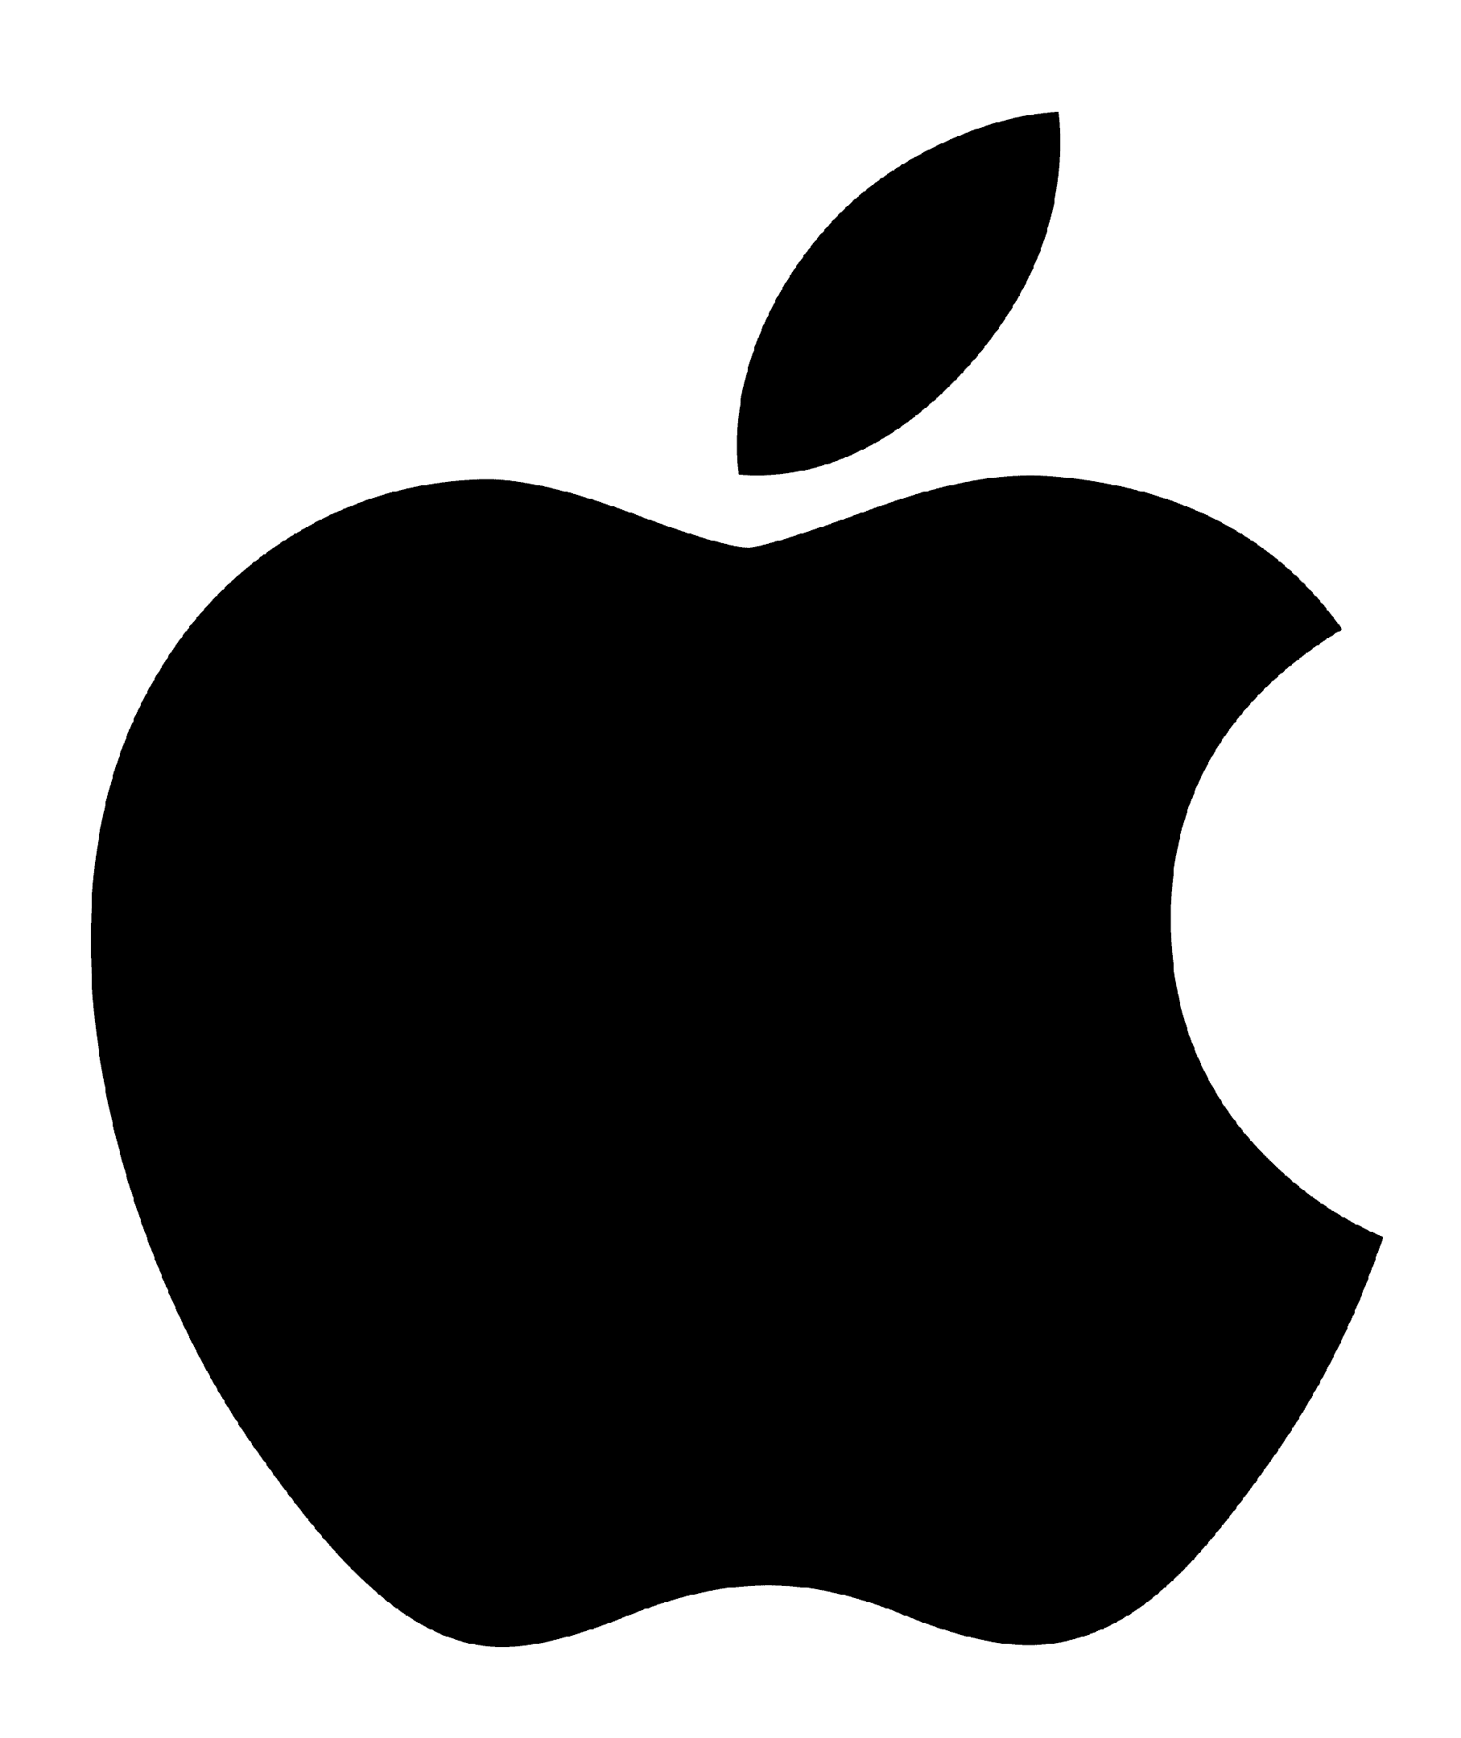

The rule of capital
The companies on the 2022 Global 2000 account for $47.6 trillion in revenues, $5.0 trillion in profits, $233.7 trillion in assets and $76.5 trillion in market cap. There are 58 countries on the 2022 list. The United States has the most with 590 companies, followed by China/Hong Kong (351) and Japan (196).
Andrea Murphy and Isabel Contreras, Forbes Global 200, 12 May 2022
The world’s richest 1%, those with more than $1 million, own 46% of the world’s wealth. Adults with less than $10,000 in wealth make up 55% of the world’s population, but hold just 1.3% of global wealth
Credit Suisse, Global Wealth Report, 2022
There 2,755 billionaires across the globe, according to the 2021 Forbes magazine ranking. The world’s 10 richest billionaires own an astonishing $1.448 trillion in combined wealth, a sum greater than the total goods and services most nations produce on an annual basis.

Slide 4
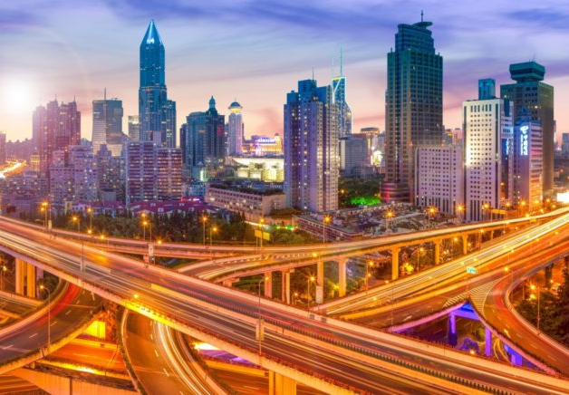
Urbanisation
In 1950, 30% of the world’s population was urban.
In 1990, 43% (2.3 billion) lived in urban areas.
By 2015, this had grown to 54% (4 billion).
By 2050, 66% are expected to be urban.
Most urbanised regions
North America (82%)
Latin America (80%)
Europe (73%)
Africa (40%)
Asia 48%.
Jean-Claude Bolay, Urban Planning Against Poverty, Future City, 14, 2020: 8-9

Slide 5
Capitalist crises
World Bank, World Development Indicators, December 2022

Slide 6
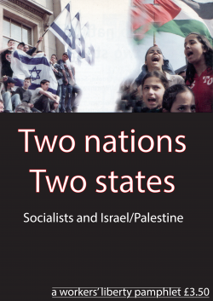
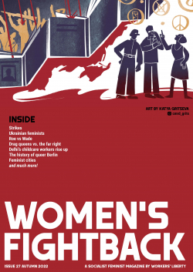
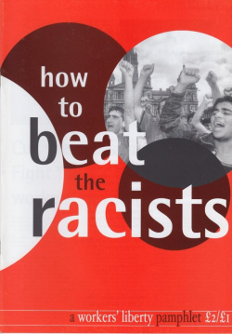
Oppression

Slide 7
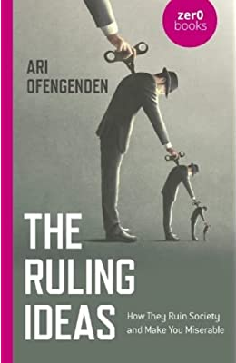
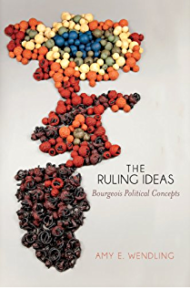
Ruling ideas
God
Nation
Market
Labour
Time
Property
Value
Crisis

Slide 8
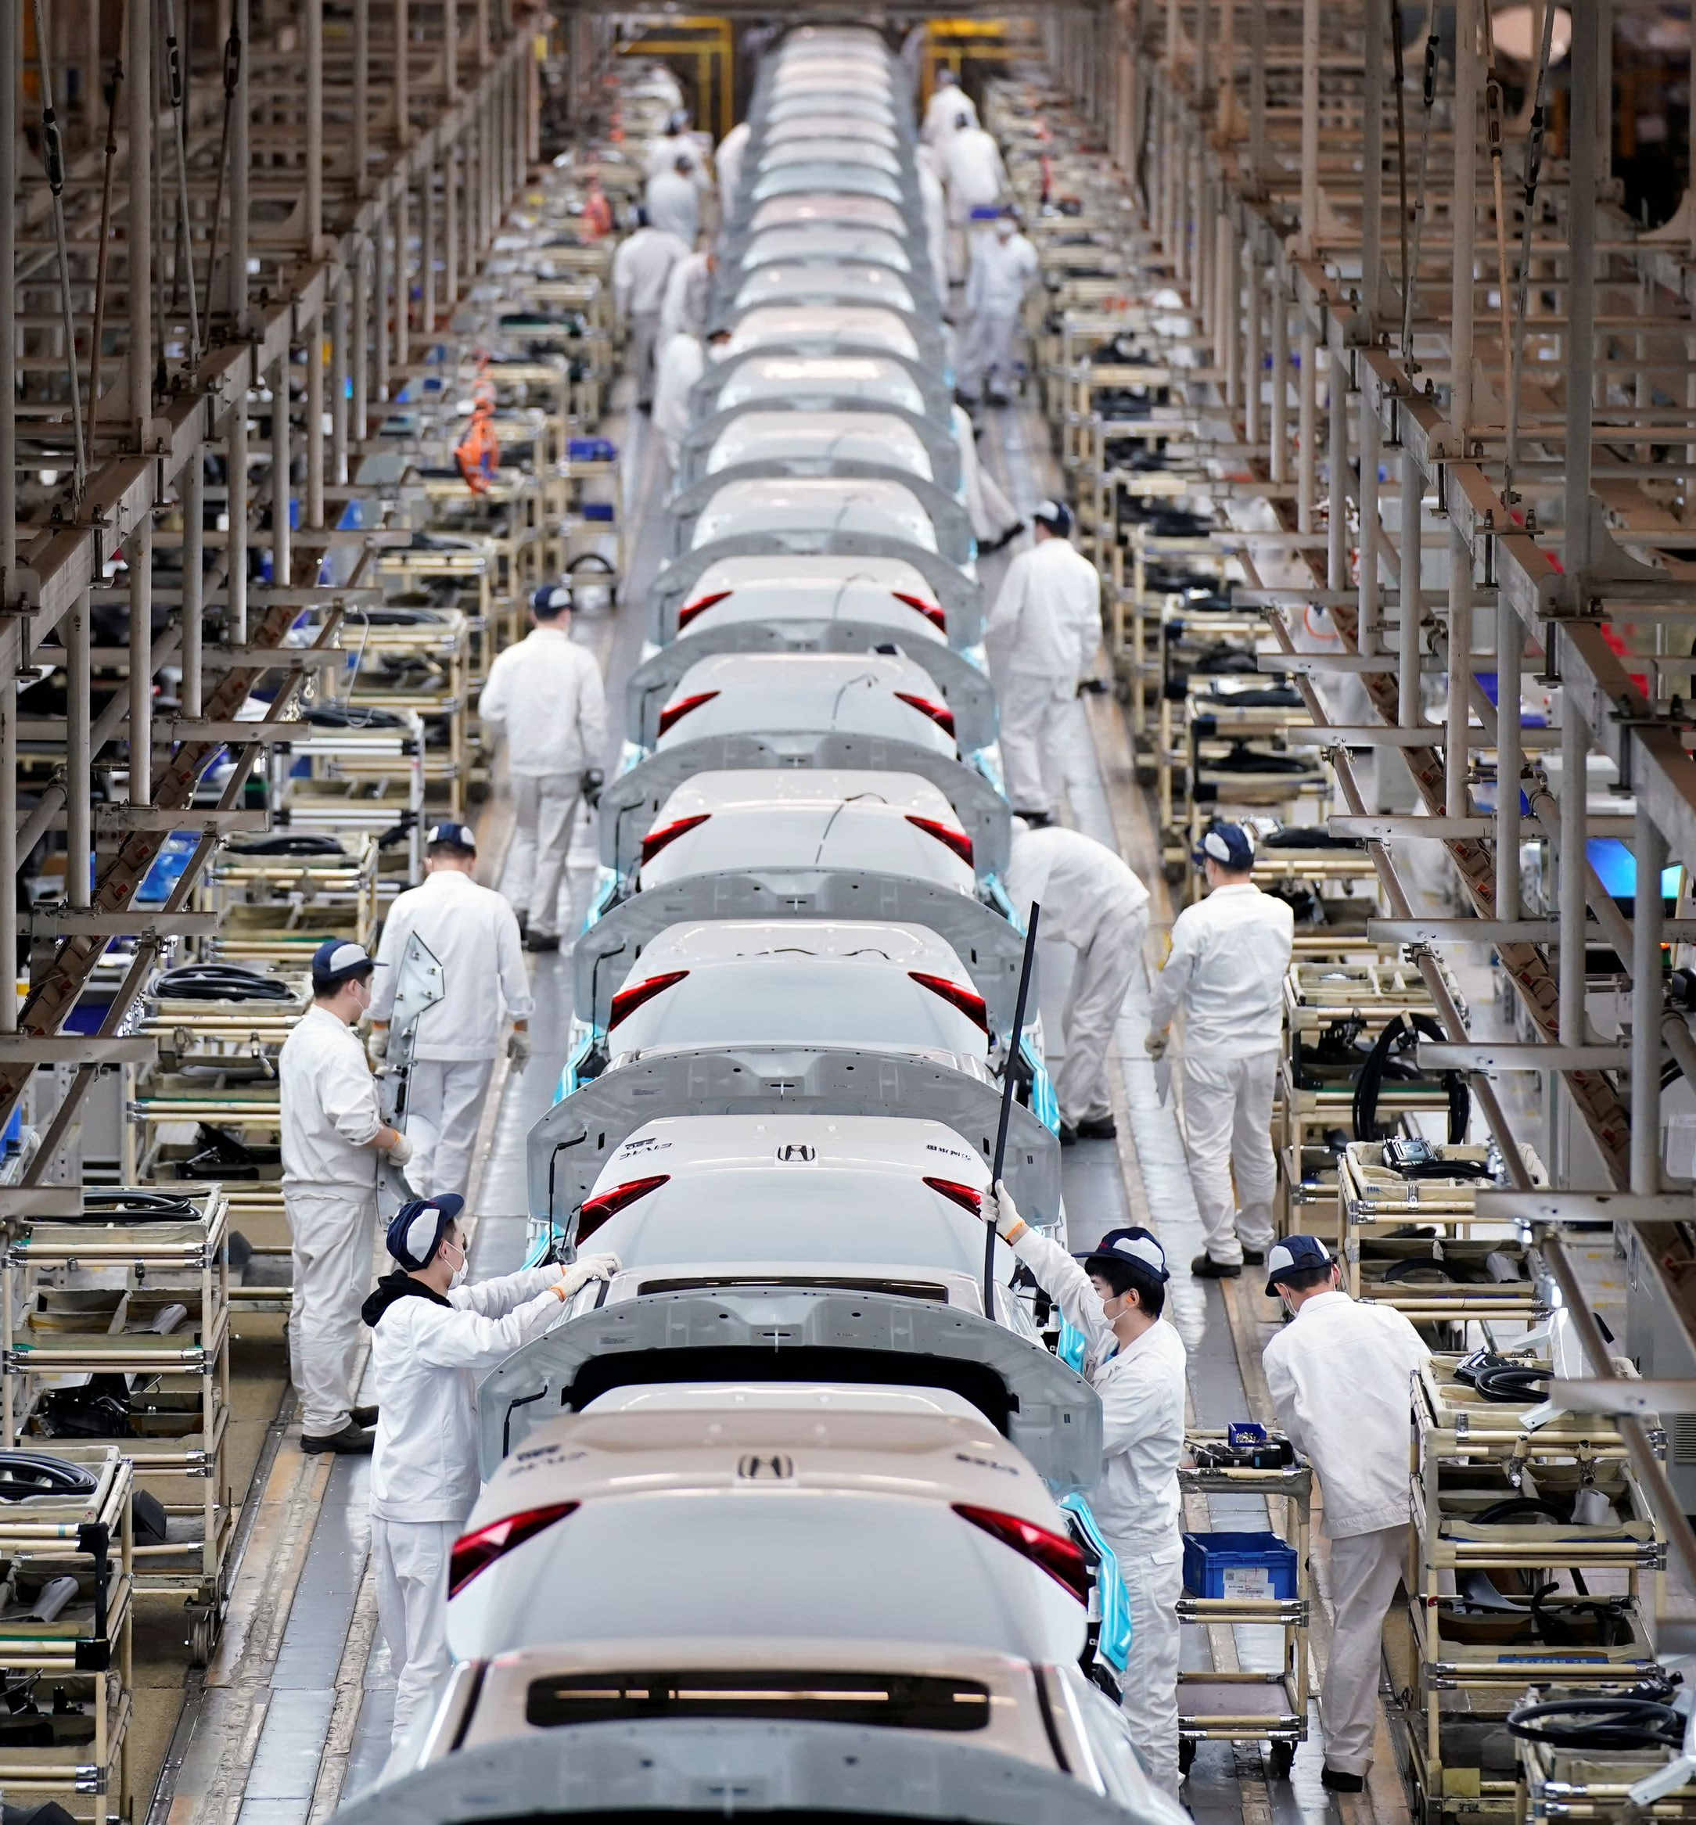
Workers of the world
“According to the International Labour Organization (ILO), the world labour force grew by 25% from 2000 to 2019. Those “employed” for an income grew from 2.6 billion to 3.3 billion over those first two decades of the twenty-first century, also by 25%...
“The manufacturing workforce grew from 393 million in 2000 to 460 million in 2019, while the industrial (manufacturing, construction, and mining) workforce grew from 536 million to 755 million over this period. Workers in transportation, communications, and utilities, who are also essential to goods production and composed an additional 226 million workers by 2019, up from 116 million two decades earlier. This industrial “core” amounted to 41% of the world’s non-agricultural workforce...”
Kim Moody, Workers of the World: Growth, Change, and Rebellion, New Politics, 2, 70, Winter 2021

Slide 9
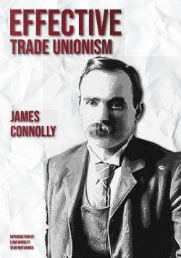
The labour movement
Across the decade since the Great Recession, we have witnessed a series of enormous general strikes (Guadeloupe and Martinique, India, Brazil, South Africa, Colombia, Chile, Algeria, Sudan, South Korea, France, and many more) as well as strike waves that have helped to topple heads of state (Tunisia, Egypt, Puerto Rico, Sudan, Lebanon, Algeria, Iraq).
David McNally, The Return of the Mass Strike, Spectre, 1, 1, 2020: 20
The European Trade Union Institute calculates that between 2010 and 2018 there were 64 general strikes in the European Union, almost half of them in Greece.
ETUI, Strikes in Europe, 7 April 2020
ITUC has more than 200 million members in 332 affiliated organisations in 163 countries and territories.

Slide 10
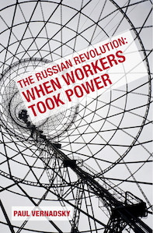
Workers’ revolutionary potential
“The working class is revolutionary, Marxists have maintained, because of its historically constituted nature as the exploited collective producer within the capitalist mode of production. As the exploited class, it is caught in a systematic clash with capital, which cannot generally and permanently satisfy its needs. As the main producing class, it has the power to halt - and within limits redirect - the economic apparatus of capitalism, in pursuit of its goals. And as the collective producer it has the objective capacity to found a new, non-exploitative mode of production. This combination of interest, power and creative capacity distinguishes the working class from every other social or political force in capitalist society, and qualifies it as the indispensable agency of socialism.”
Francis Mulhern, New Left Review, I/148, 1984: 22-3

Slide 11
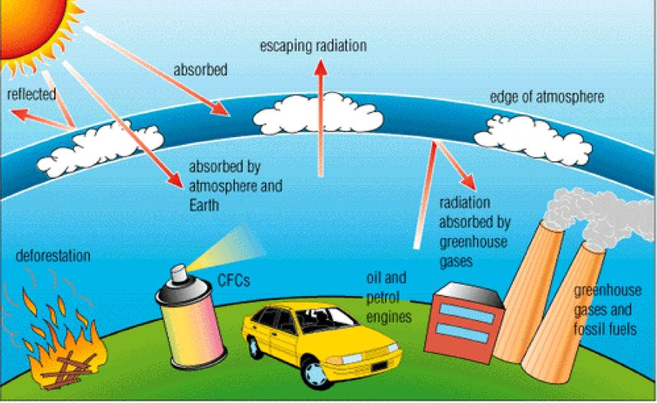
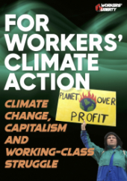
Climate change

Slide 12
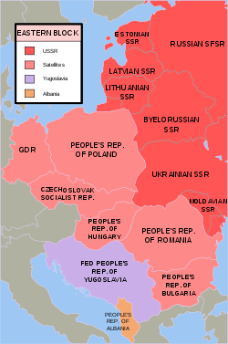
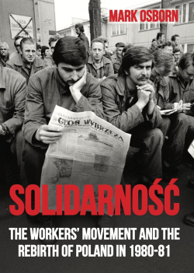
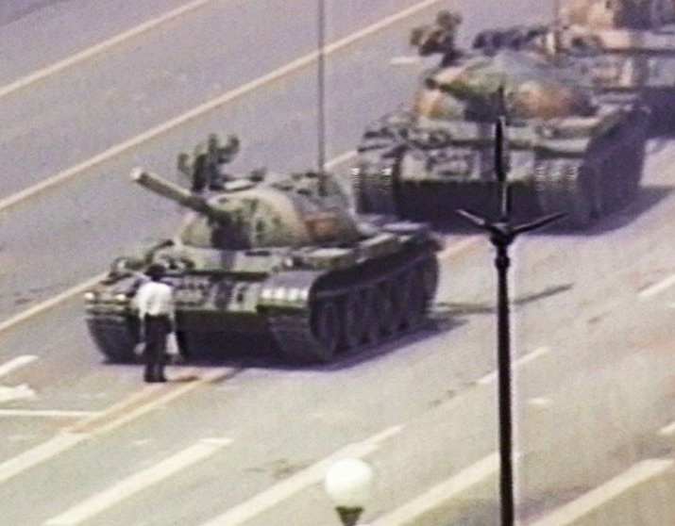
Stalinism

Slide 13
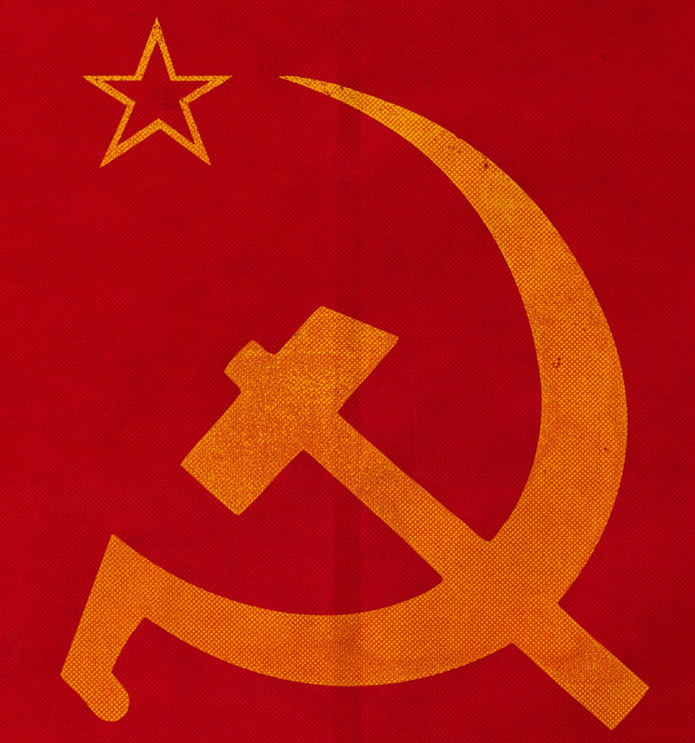
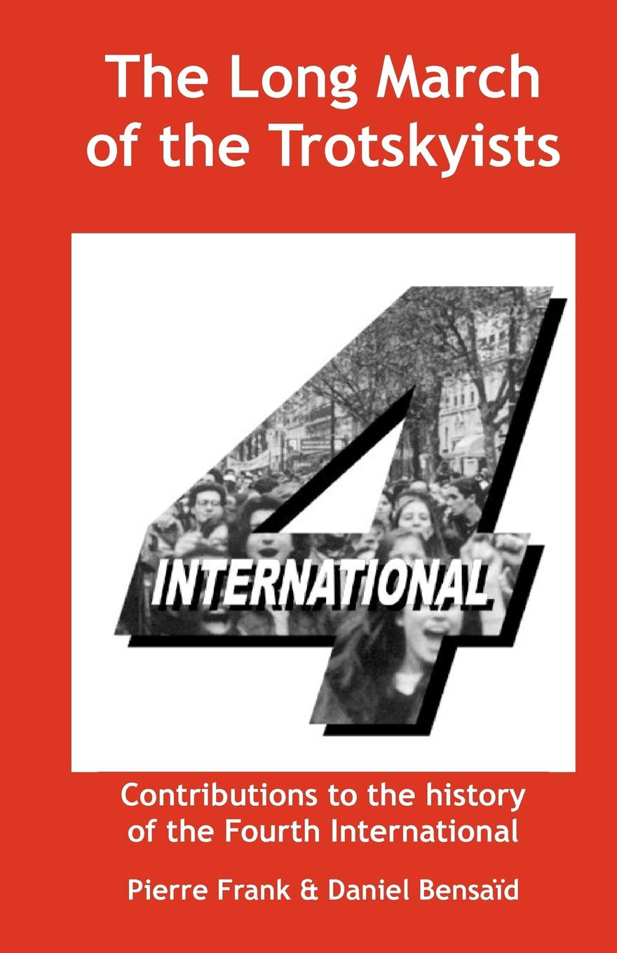
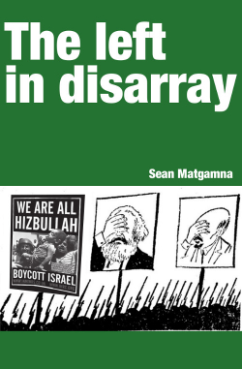
The revolutionary left

Slide 14
Discussion
Questions
1) Does the fight for socialism inevitably lead to the horrors of Stalinism?
2) Does socialism depend on the assumption of human virtue and cooperation?
3) Has capitalism shown that is the most efficient social system humanity is capable of organising?
4) Are workers so fragmented, divided and bought off that they will never fight for socialism?
5) Does the disarray on the global revolutionary left show that Marxism has no prospect of success?
6) Given planetary boundaries, is it too late for working class socialism?
Concepts
• Stalinism
• Human nature
• Contemporary capitalism
• Working class agency
• Totalitarianism
• “wrong species”
• There is no alterative
• The labour movement
• The revolutionary left

