Slide 1
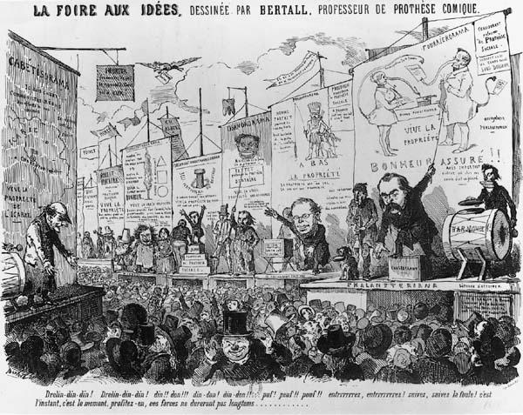
Session 3: Critique of other socialisms
1765 Facchinei “socialisti” followers of Rousseau.
1822 Edward Cowper “socialist” in letter to Robert Owen.
1826 William Hazlitt “those profound and redoubted socialists, Aquinas and Scotus”.
1827 Socialist in London Co-operative Magazine.
1831 Alexandre Vinet discussed socialisme in Le Semeur, a Protestant journal.
1832 Xavier Joncières used socialisme to describe new system of social organisation in Le Globe.
1840 Sozialist and sozialistisch in German.
1840 Communist and communism

Slide 2
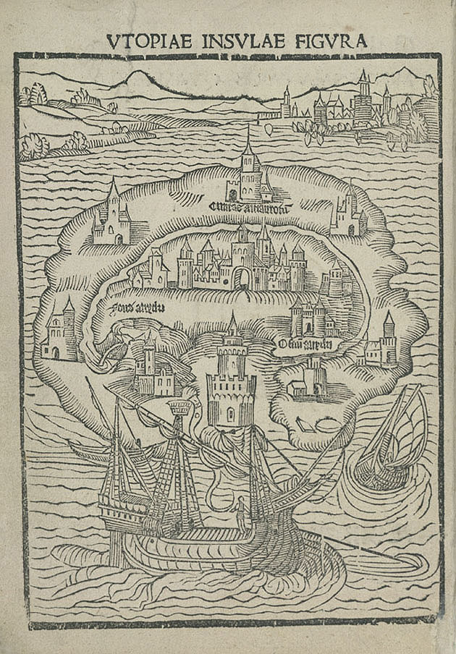
1a. Reactionary: feudal socialism
Thomas More, Utopia (1551)
Tommaso Campanella, The City of the Sun (1623)
“Feudal Socialism: half lamentation, half lampoon; half an echo of the past, half menace of the future; at times, by its bitter, witty and incisive criticism, striking the bourgeoisie to the very heart’s core; but always ludicrous in its effect, through total incapacity to comprehend the march of modern history.”
“Nothing is easier than to give Christian asceticism a socialist tinge… Christian socialism is but the holy water with which the priest consecrates the heart-burnings of the aristocrat.”

Slide 3
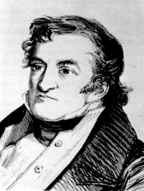
1b. Reactionary: petty-bourgeois socialism
“In countries like France, where the peasants constitute far more than half of the population, it was natural that writers who sided with the proletariat against the bourgeoisie should use, in their criticism of the bourgeois régime, the standard of the peasant and petty bourgeois, and from the standpoint of these intermediate classes, should take up the cudgels for the working class. Thus arose petty-bourgeois Socialism. Sismondi was the head of this school, not only in France but also in England.”
“In its positive aims, however, this form of socialism aspires either to restoring the old means of production and of exchange, and with them the old property relations, and the old society, or to cramping the modern means of production and of exchange within the framework of the old property relations that have been, and were bound to be, exploded by those means. In either case, it is both reactionary and utopian.”

Slide 4
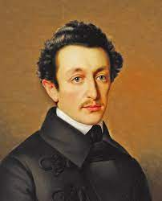
1c. Reactionary: German or ‘True’ Socialism
“By this, the long-wished for opportunity was offered to ‘True’ Socialism of confronting the political movement with the socialist demands, of hurling the traditional anathemas against liberalism, against representative government, against bourgeois competition, bourgeois freedom of the press, bourgeois legislation, bourgeois liberty and equality, and of preaching to the masses that they had nothing to gain, and everything to lose, by this bourgeois movement.”
“While this ‘True’ Socialism thus served the government as a weapon for fighting the German bourgeoisie, it, at the same time, directly represented a reactionary interest, the interest of German Philistines. In Germany, the petty-bourgeois class, a relic of the sixteenth century, and since then constantly cropping up again under the various forms, is the real social basis of the existing state of things.”

Slide 5
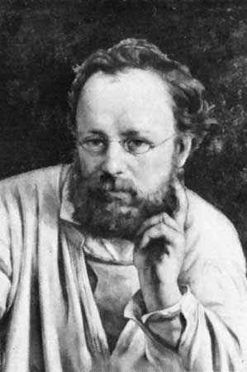
2. Conservative or Bourgeois Socialism
“To this section belong economists, philanthropists, humanitarians, improvers of the condition of the working class, organisers of charity, members of societies for the prevention of cruelty to animals, temperance fanatics, hole-and-corner reformers of every imaginable kind… We may cite Proudhon’s Philosophie de la Misère as an example of this form.”
“It but requires in reality, that the proletariat should remain within the bounds of existing society… administrative reforms, based on the continued existence of these relations; reforms, therefore, that in no respect affect the relations between capital and labour, but, at the best, lessen the cost, and simplify the administrative work, of bourgeois government.”

Slide 6
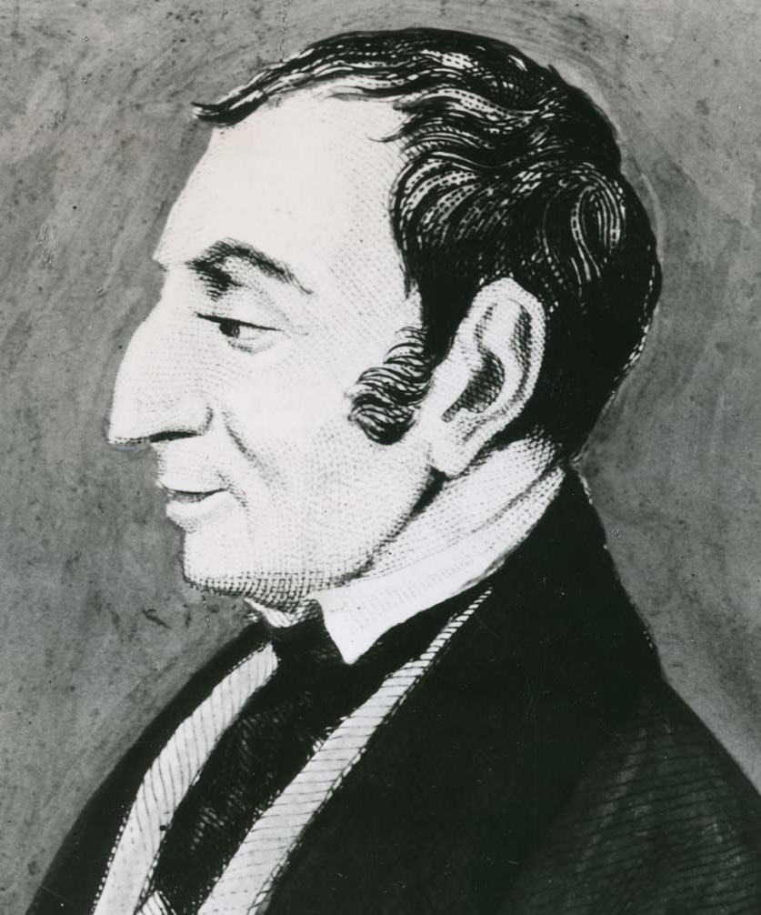
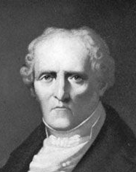
3a. Critical-Utopian Socialism: Forerunners
“The Socialist and Communist systems, properly so called, those of Saint-Simon, Fourier, Owen, and others…”
“The most direct way to bring about an improvement in the moral and physical well-being of the majority of the population is to give priority in state expenditure to the provision of work for all fit men, so as to assure their physical existence; to disseminate as quickly as possible among the proletarian class the positive knowledge which has been acquired; and to ensure that the individuals composing this class have forms of leisure and interests which will develop their intelligence.”
Saint-Simon, Fragments on Social Organisation (1825)
“Social progress and changes of historical period take place in proportion to the advance of women toward liberty, and social decline occurs as a result of the diminution of the liberty of women... The extension of the privileges of women is the fundamental cause of all social progress.”
Fourier, The Theory of the Four Movements (1808)

Slide 7
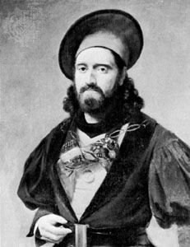
3b. Critical-Utopian Socialism: Saint-Simonians
“The exploitation of man by his fellows, whatever its origin may be, is the most characteristic phenomenon of the past… Men may then be divided into two classes, the exploiters and the exploited… At last the exploitation of man by man, which we have shown in its most direct and uncouth form in the past, namely slavery, continues to a very large extent in the relations between owners and workers, masters and wage earners. Of course, the respective conditions of the classes today are far from those of masters and slaves, patricians and plebeians, or lords and serfs in the past... If the exploitation of man by man no longer has the brutal character of antiquity and assumes more gentle forms today, it is, nevertheless, no less real… The exploitation of man by man must disappear. The constitution of property which is hereby perpetuated must, therefore, also disappear…
“The doctrine of Saint-Simon does not want to bring about an upheaval or a revolution… through slow and successive transformation… peaceful and gradual.”
Bazard and Enfantin (1828-29) The Doctrine of Saint-Simon (1828-29)

Slide 8
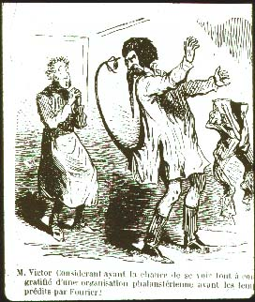
3c. Critical-Utopian Socialism: Fourierists
“Society tends to be divided more and more sharply into two major classes… The desperate struggles… of bosses against workers, of workers against bosses, of each against all and of all against each, are not inevitable conditions of human existence.”
Victor Considérant, Manifeste de la démocratie pacifique (1843)
“We are not communists. We believe that the principle of individual property is a right, a sacred right, without which there can be no lasting and stable society.”
Victor Considérant, Pour en finir avec M. Cabet (1846)
“[King Louis Philippe] laying the first stone of the first Phalanstery”.
Victor Considérant, Destinée sociale, Dedication, 2nd edition (1847)

Slide 9
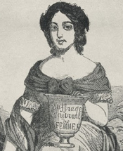
Socialist feminism
“Saint-Simonian women constituted themselves into a separate section in the movement in 1829, and took the initiative in running evening classes for artisans. Their leader was Claire Bazard… and Eugénie Niboyet also took a leading role. Several dynamic young seamstresses attended their classes and became important in the movement, notably Marie-Reine Guindorf, Désirée Véret and Jeanne Deroin… In 1829 the women’s section in Paris had 200 regular members and groups developed in provincial cities, notably Lyon and Nantes… Véret and Guindorf started a tiny newspaper for women, La Femme Libre, in August 1832… The paper survived until February 1834, appearing irregularly, 32 times in all; 1,000 copies of the first issue were printed…”
Pamela Pilbeam, French Socialists before Marx (2000)

Slide 10
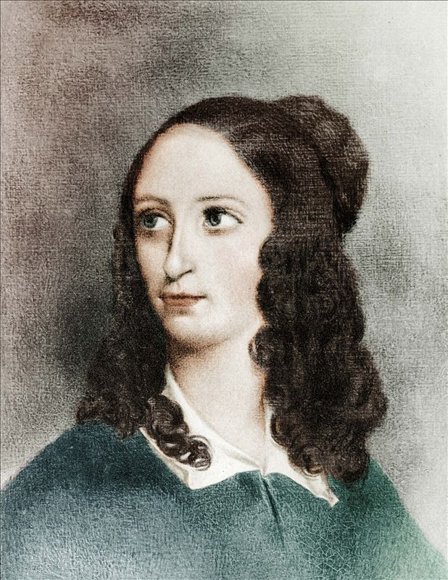
Flora Tristan
“Workers… Now the day has come when one must act, and it is up to you and only you to act in the interest of your own cause… So leave your isolation: unite! Unity gives strength. You have numbers going for you, and numbers are significant. I come to you to propose a general union among working men and women, regardless of trade, who reside in the same region – a union which would have as its goal the consolidation of the working class…
“I am not a revolutionary or an anarchist or a bloodthirsty person… Yes, I ask that the working class be unified in one body and have representation in the Chamber… a measure in favour of order… To ask for a defender for the working class is to want to replace the anonymous charlatans by a well-known university doctor…”
Tristan, The Workers’ Union (1843)

Slide 11
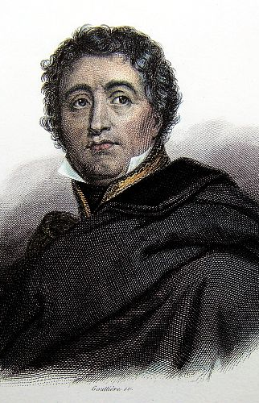
Gracchus Babeuf
“A republic where the immense majority is in command and is sovereign; where every citizen enjoys the same rights; where we don't see unbridled luxury insulting the most terrible poverty; from which penury and corruption are banished; where every member of society can rely on subsistence, independently of the whims of fortune or of any individual; where virtue is honoured and crime punished; where in short true equality reigns, that is, common happiness.”
Babeuf, Le Eclaireur, No.4 (1895)
“Nobody can, without committing a crime, exclusively expropriate the goods of the earth or of industry. Unhappiness and slavery flow from inequality, and the latter from property. Property is thus the greatest of society’s plagues. It is a veritable public offence.”
Analysis of the Doctrine of Babeuf. Flypost (April 1796)

Slide 12
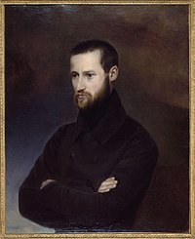
Louis-August Blanqui
“Yes, gentlemen, this is the war between rich and poor: the rich wanted it so, for they are the aggressors. And yet they think it wrong that the poor resist.”
Blanqui, Defence Speech at the Trial (12 January 1832)
“In a word, we are always and everywhere with the oppressed against the oppressors... It makes no difference if oppression takes the form of military or commercial aristocracy, or if the people are exploited by the sabre or the coin; our hearts are moved with the same pity for the sufferings of the peasant trampled by his master’s steed as for the agony of the worker whose blood serves to oil the gears of his industrial overlord.”
Blanqui Equality Is Our Flag (2 February 1834)

Slide 13
Communist League
1834 | League of the Outlawed (Bund der Geächteten) founded.
1836 | Members of League of the Outlawed formed League of the Just (Bund der Gerechten).
1838 | The League of the Just commissioned Weitling’s Mankind As It Is and As It Ought To Be.
1846 | League reply to Marx’s letter, 6 June 1846, for communication among communists
1847 | Moll to Brussels, 20 January 1847 to encourage Marx and Engels to join the League.
 | League of the Just convened its first international congress in London from 2 to 9 June 1847. Name changed to Communist League (Bund der Kommunisten). Adopted the new slogan Workers of all Countries, Unite! (Proletarier aller Lander vereinigt Euch!)
 | Kommunistische Zeitschrift, newspaper of the Communist League, September 1847.
 | Second congress of the Communist League, London, 29 November to 10 December 1847. Rules Article 1: “The aim of the League is the overthrow of the bourgeoisie, the rule of the proletariat, the abolition of the old bourgeois society which rests on the antagonism of classes, and the foundation of a new society without classes and without private property.”

Slide 14
Discussion
Questions
1) What is the defining feature of reactionary socialism?
2) What is the defining feature of bourgeois socialism?
3) What is the defining feature of utopian socialism?
4) Discuss modern examples of: reactionary socialism; bourgeois socialism and utopian socialism.
5) Is this division of socialists useful?
6) What other ways of evaluating forms of socialism are there?
7) Which other Communists doesn’t Marx criticise in the Manifesto? Why?
Concepts
• Reactionary socialism
• Bourgeois socialism
• Utopian socialism
• Saint-Simonian
• Fourierist
• Owenite
• Socialism from above and below
• Communists

