Slide 1
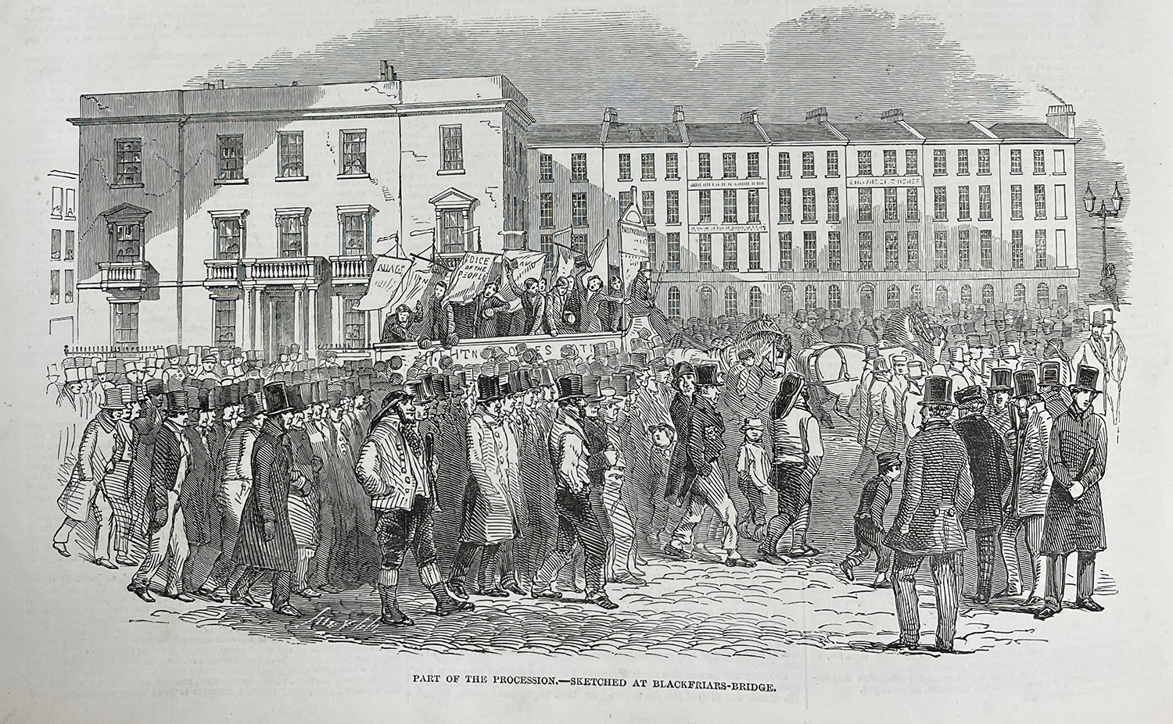
Session 2: Workers and Marxists
“The Communists do not form a separate party opposed to the other working-class parties.
“They have no interests separate and apart from those of the proletariat as a whole.
“They do not set up any sectarian principles of their own, by which to shape and mould the proletarian movement.”
Draper notes “special”, not separate or sectarian.
IV: “The Communists fight for the attainment of the immediate aims, for the enforcement of the momentary interests of the working class; but in the movement of the present, they also represent and take care of the future of that movement.”

Slide 2
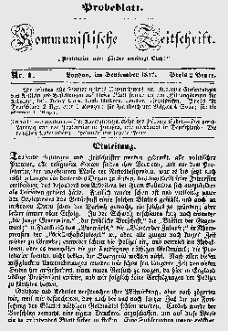
Most advanced and resolute workers
“The Communists are distinguished from the other working-class parties by this only: 1. In the national struggles of the proletarians of the different countries, they point out and bring to the front the common interests of the entire proletariat, independently of all nationality. 2. In the various stages of development which the struggle of the working class against the bourgeoisie has to pass through, they always and everywhere represent the interests of the movement as a whole.”
“The Communists, therefore, are on the one hand, practically, the most advanced and resolute section of the working-class parties of every country, that section which pushes forward all others; on the other hand, theoretically, they have over the great mass of the proletariat the advantage of clearly understanding the line of march, the conditions, and the ultimate general results of the proletarian movement.”

Slide 3
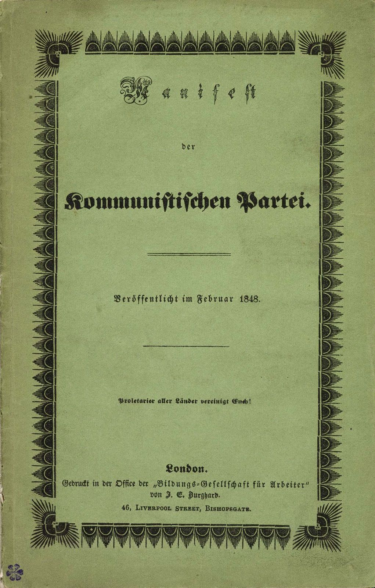
Conquest of political power by the proletariat
“The immediate aim of the Communists is the same as that of all other proletarian parties: formation of the proletariat into a class, overthrow of the bourgeois supremacy, conquest of political power by the proletariat.”
“The theoretical conclusions of the Communists are in no way based on ideas or principles that have been invented, or discovered, by this or that would-be universal reformer. They merely express, in general terms, actual relations springing from an existing class struggle, from a historical movement going on under our very eyes.”

Slide 4

Abolition of private property
“The distinguishing feature of Communism is not the abolition of property generally, but the abolition of bourgeois property. But modern bourgeois private property is the final and most complete expression of the system of producing and appropriating products, that is based on class antagonisms, on the exploitation of the many by the few.
In this sense, the theory of the Communists may be summed up in the single sentence:
Abolition of private property.”

Slide 5
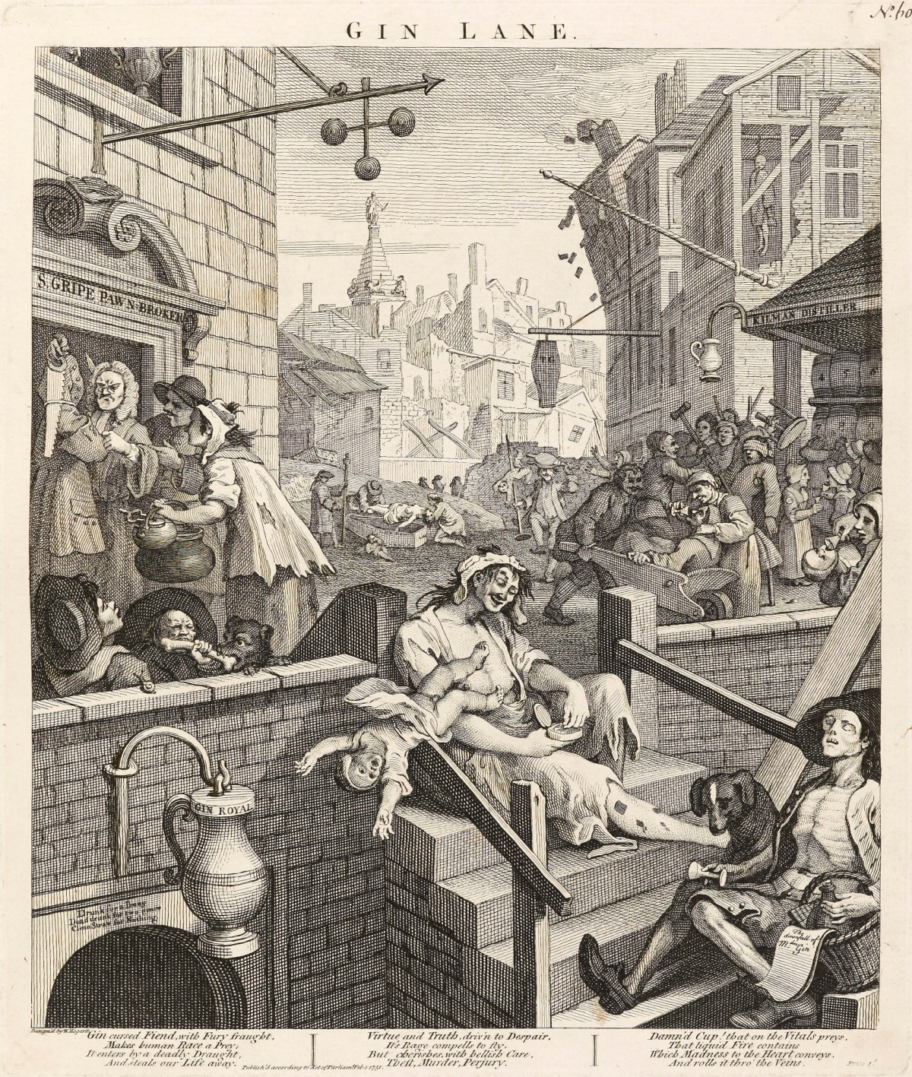
Objections: personal property and work
“We Communists have been reproached with the desire of abolishing the right of personally acquiring property…”
“It has been objected that upon the abolition of private property, all work will cease, and universal laziness will overtake us.”
“[Humans] begin to distinguish themselves from animals as soon as they begin to produce their means of subsistence – their food, shelter and clothing.”
Marx and Engels (1845-46) The German Ideology. MECW 5: 31

Slide 6
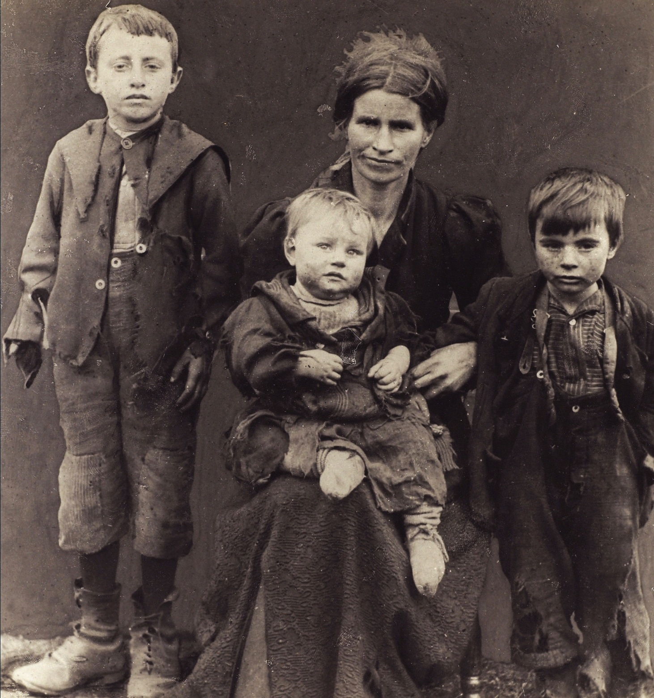
Objections: the family
“Abolition of the family! Even the most radical flare up at this infamous proposal of the Communists.”
I: “The bourgeoisie has torn away from the family its sentimental veil, and has reduced the family relation to a mere money relation...”
“the family, where the wife and the children are slaves of the husband.”
Marx and Engels (1845-46) The German Ideology. MECW 5: 46

Slide 7
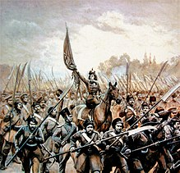
Objections: nationality
“The Communists are further reproached with desiring to abolish countries and nationality.”
“The workers have no fatherland…” [HD]
“We German democrats have a special interest in the liberation of Poland… A nation cannot become free and at the same time continue to oppress other nations. The liberation of Germany cannot therefore take place without the liberation of Poland from German oppression.”
Engels (29 November 1847) Speech in London to mark the 17th anniversary of the Polish insurrection of 1830. MECW 6: 389

Slide 8
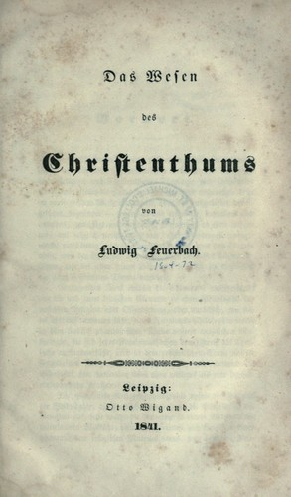
Objections: religion
“The charges against Communism made from a religious, a philosophical and, generally, from an ideological standpoint, are not deserving of serious examination.”
“Religion is the sigh of the oppressed creature, the heart of a heartless world, just as it is the spirit of spiritless conditions. It is the opium of the people.”
Marx (1843-44) Contribution to Critique of Hegel's Philosophy of Law. Introduction. MECW 3: 175
“Of all that has been achieved by German philosophy the critique of religion is the most important thing... It gives us the certainty that the old society is coming to an end and that the edifice of fraud and prejudice is collapsing.”
Marx (30 November 1847) Report to London German Workers' Educational Society. MECW 6: 631

Slide 9
Ruling ideas
“The ruling ideas of each age have ever been the ideas of its ruling class.”
“The ideas of the ruling class are in every epoch the ruling ideas, i.e. the class which is the ruling material force of society, is at the same time its ruling intellectual force. The class which has the means of material production at its disposal, has control at the same time over the means of mental production, so that thereby, generally speaking, the ideas of those who lack the means of mental production are subject to it. The ruling ideas are nothing more than the ideal expression of the dominant material relationships, the dominant material relationships grasped as ideas; hence of the relationships which make the one class the ruling one, therefore, the ideas of its dominance. The individuals composing the ruling class possess among other things consciousness, and therefore think. Insofar, therefore, as they rule as a class and determine the extent and compass of an epoch, it is self-evident that they do this in its whole range, hence among other things rule also as thinkers, as producers of ideas, and regulate the production and distribution of the ideas of their age: thus their ideas are the ruling ideas of the epoch.”
Marx and Engels (1845-46) The German Ideology. MECW 5: 59

Slide 10
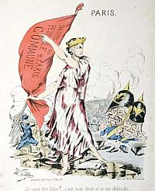
Communist programme
“The first step in the revolution by the working class is to raise the proletariat to the position of ruling class to win the battle of democracy.”
“The proletariat will use its political supremacy to wrest, by degree, all capital from the bourgeoisie, to centralise all instruments of production in the hands of the state, i.e., of the proletariat organised as the ruling class; and to increase the total productive forces as rapidly as possible.”
“Of course, in the beginning, this cannot be effected except by means of despotic inroads on the rights of property…”

Slide 11
Transitional demands
1. Abolition of property in land and application of all rents of land to public purposes.
2. A heavy progressive or graduated income tax.
3. Abolition of all rights of inheritance.
4. Confiscation of the property of all emigrants and rebels.
5. Centralisation of credit in the hands of the state, by means of a national bank with state capital and an exclusive monopoly.
6. Centralisation of the means of communication and transport in the hands of the state.
7. Extension of factories and instruments of production owned by the state; the bringing into cultivation of waste-lands, and the improvement of the soil generally in accordance with a common plan.
8. Equal liability of all to work. Establishment of industrial armies, especially for agriculture.
9. Combination of agriculture with manufacturing industries; gradual abolition of all the distinction between town and country by a more equable distribution of the populace over the country.
10. Free education for all children in public schools. Abolition of children’s factory labour in its present form. Combination of education with industrial production, etc, etc.

Slide 12
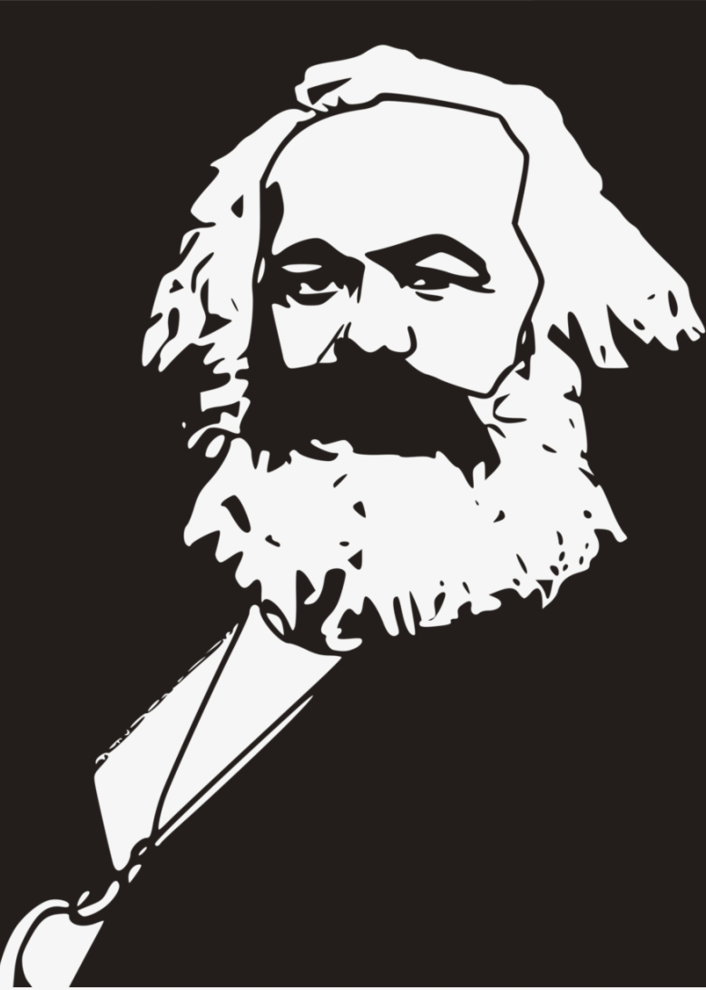
Communism
“In place of the old bourgeois society, with its classes and class antagonisms, we shall have an association, in which the free development of each is the condition for the free development of all.”
“Freedom, in this sphere, can consist only in this, that socialised man, the associated producers, govern their metabolic interaction with nature rationally, bringing it under their collective control instead of being dominated by it as a blind power; accomplishing this metabolism with the smallest expenditure of energy and in conditions most worthy and appropriate for their human nature.”
Marx (1865) Capital, Volume III. MECW 37: 807
“From each according to their abilities, to each according to their needs!”
Marx (May 1875) Critique of the Gotha Programme. MECW 24: 87

Slide 13
Discussion
Questions
1) Were Marx and Engels opposed to Communist Party organisation?
2) Do Communists want to take away individual’s personal possessions?
3) Do Communists want to abolish the family?
4) What is the Marxist attitude towards nations and nationalism?
5) Is it true that “the ruling ideas of each age have ever been the ideas of its ruling class”?
6) What does Marx mean by “winning the battle of democracy”?
7) What sort of demands are made in the 10-point programme? Are they obsolete today?
8) How does Marx describe the final goal of Communism?
9) Is Marxism inevitably sectarian?
Concepts
• Party and class
• Ruling ideas
• Programme
• Personal possessions
• Work
• Family
• Nationality
• Religion

