Slide 1
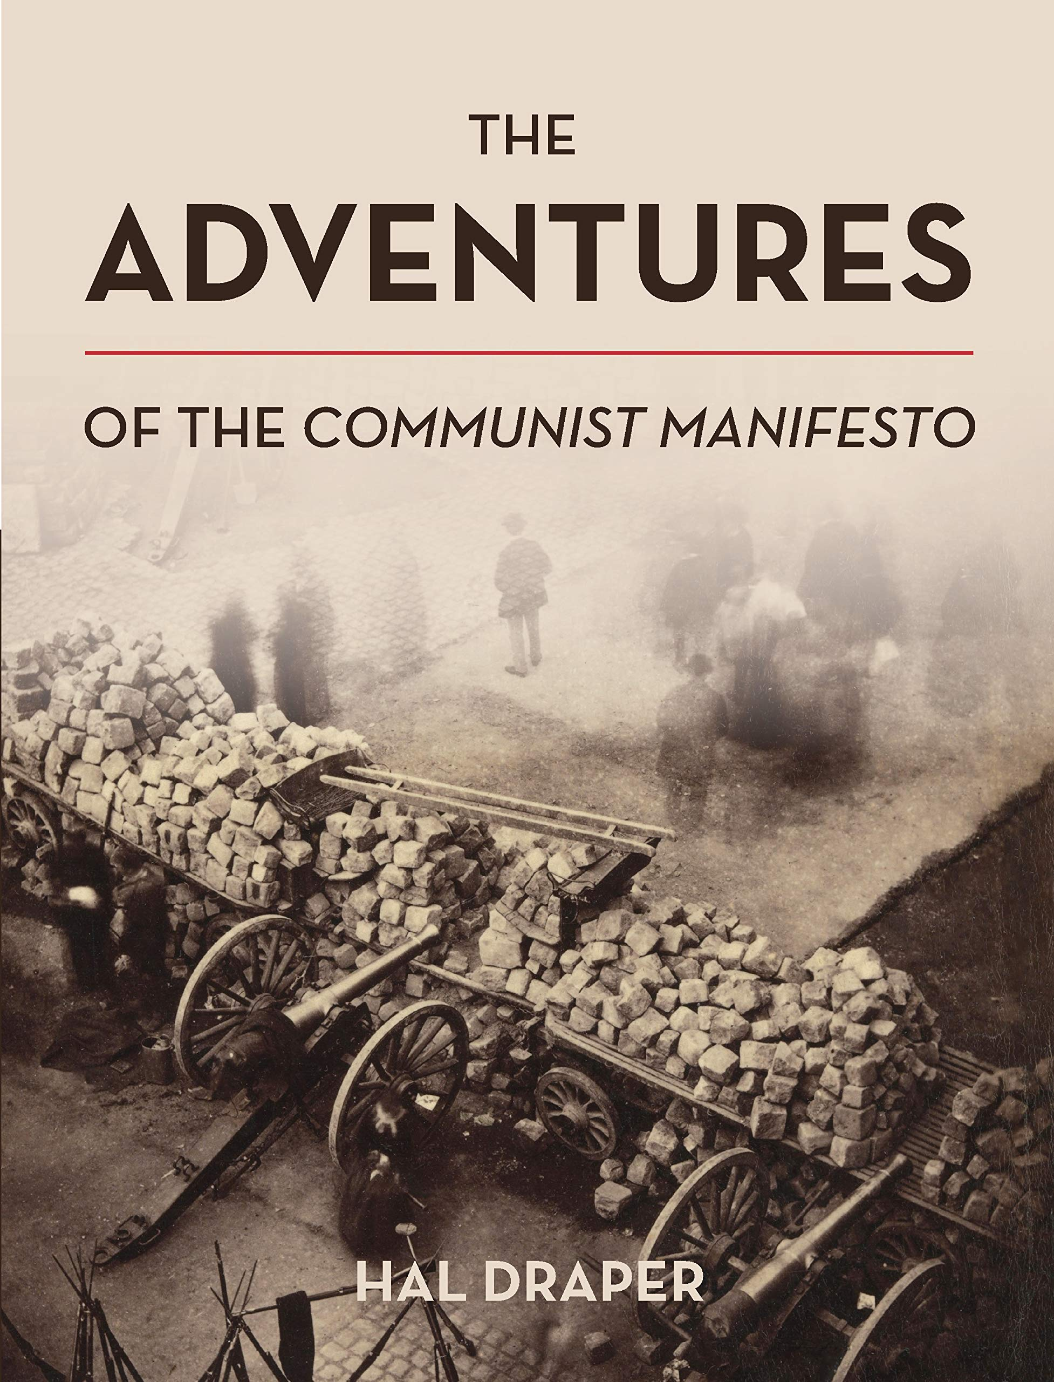
The Communist Manifesto
Session 1: Class and class struggle
The Communist Manifesto: I Bourgeois and Proletarians
Session 2: Workers and Marxists
The Communist Manifesto: II Proletarians and Communists
Session 3: Critique of other socialisms
The Communist Manifesto: III: Socialist and Communist Literature
Session 4: Class and revolution
The Communist Manifesto: IV: Position of the Communists
Session 5: Controversies and relevance
Matgamna, The Communist Manifesto after Stalinism, WL 44 (1998)

Slide 2
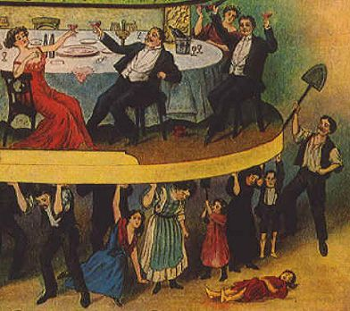
Session 1: Class and class struggle
“The history of all hitherto existing society is the history of class struggles. Freeman and slave, patrician and plebeian, lord and serf, guild-master and journeyman, in a word, oppressor and oppressed, stood in constant opposition to one another… In ancient Rome we have patricians, knights, plebeians, slaves; in the Middle Ages, feudal lords, vassals, guild-masters, journeymen, apprentices, serfs; in almost all of these classes, again, subordinate gradations… an uninterrupted, now hidden, now open fight, a fight that each time ended, either in a revolutionary reconstitution of society at large, or in the common ruin of the contending classes.”

Slide 3
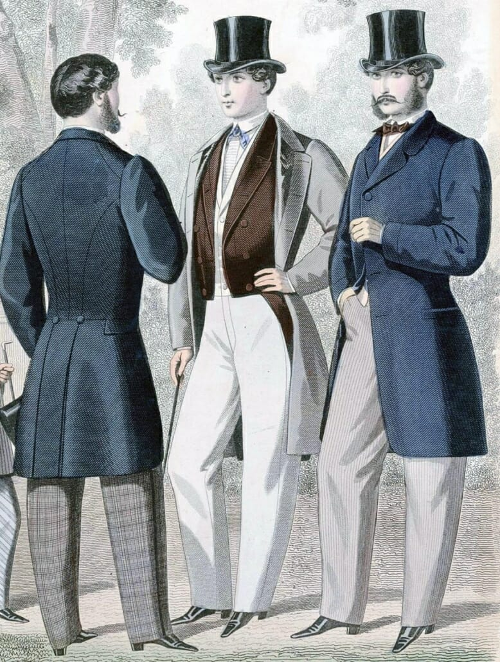
The bourgeoisie
“The bourgeoisie, historically, has played a most revolutionary part. The bourgeoisie, wherever it has got the upper hand, has put an end to all feudal, patriarchal, idyllic relations. It has pitilessly torn asunder the motley feudal ties that bound man to his ‘natural superiors’, and has left remaining no other nexus between man and man than naked self-interest, than callous ‘cash payment’…”
“The bourgeoisie… has accomplished wonders far surpassing Egyptian pyramids, Roman aqueducts, and Gothic cathedrals; it has conducted expeditions that put in the shade all former Exoduses of nations and crusades. The bourgeoisie cannot exist without constantly revolutionising the instruments of production, and thereby the relations of production, and with them the whole relations of society…”

Slide 4
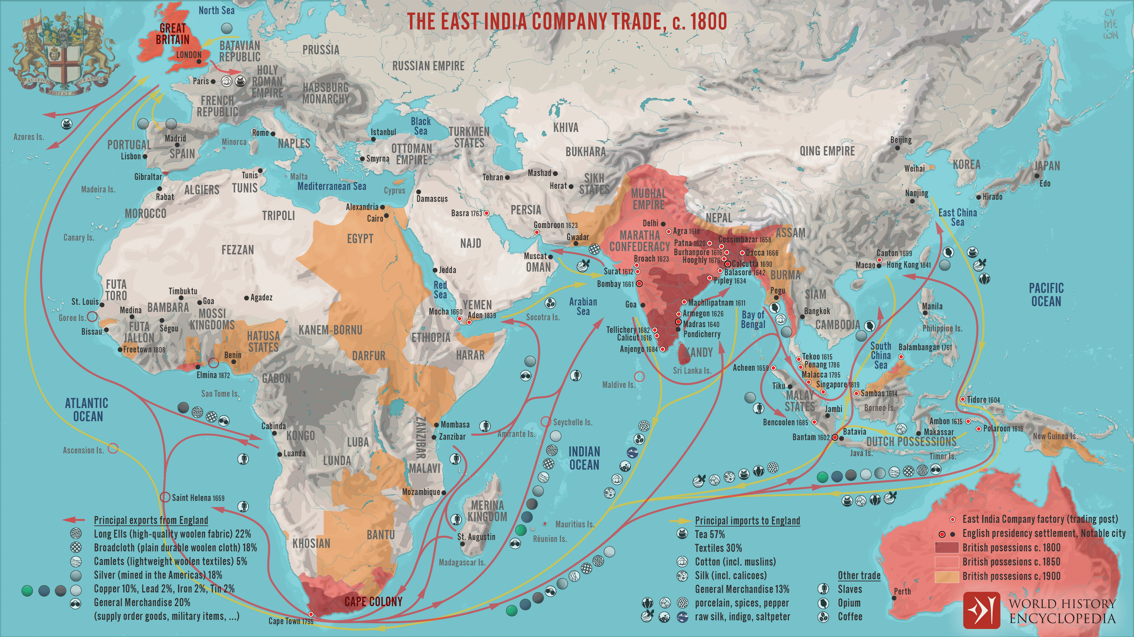
Capitalist globalisation
“The need of a constantly expanding market for its products chases the bourgeoisie over the entire surface of the globe. It must nestle everywhere, settle everywhere, establish connexions everywhere.
“The bourgeoisie has through its exploitation of the world market given a cosmopolitan character to production and consumption in every country…”

Slide 5
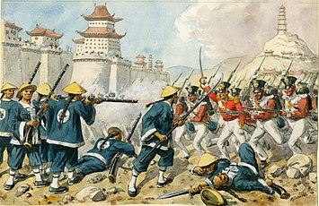
Capitalist imperialism
“The bourgeoisie, by the rapid improvement of all instruments of production, by the immensely facilitated means of communication, draws all, even the most barbarian, nations into civilisation. The cheap prices of commodities are the heavy artillery with which it batters down all Chinese walls, with which it forces the barbarians’ intensely obstinate hatred of foreigners to capitulate. It compels all nations, on pain of extinction, to adopt the bourgeois mode of production; it compels them to introduce what it calls civilisation into their midst, i.e., to become bourgeois themselves. In one word, it creates a world after its own image…”

Slide 6
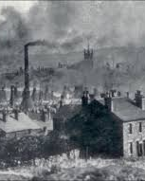
Capitalist urbanisation and industrialisation
“The bourgeoisie has subjected the country to the rule of the towns. It has created enormous cities, has greatly increased the urban population as compared with the rural, and has thus rescued a considerable part of the population from the idiocy [isolation] of rural life. Just as it has made the country dependent on the towns, so it has made barbarian and semi-barbarian countries dependent on the civilised ones, nations of peasants on nations of bourgeois, the East on the West…
“The bourgeoisie, during its rule of scarce one hundred years, has created more massive and more colossal productive forces than have all preceding generations together. Subjection of nature’s forces to man, machinery, application of chemistry to industry and agriculture, steam-navigation, railways, electric telegraphs, clearing of whole continents for cultivation, canalisation of rivers, whole populations conjured out of the ground…”

Slide 7
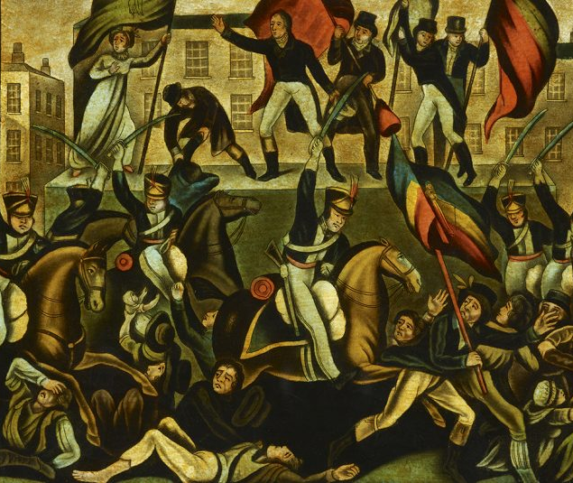
The state
“The executive of the modern state is but a committee for managing the common affairs of the whole bourgeoisie.”
II: “Political power, properly so called, is merely the organised power of one class for oppressing another.”
“One thing especially was proved by the [Paris] Commune, viz., that ‘the working class cannot simply lay hold of the ready-made state machinery, and wield it for its own purposes’.”
Marx and Engels (24 June 1872) Preface to the ‘new’ German edition. MECW 23: 175

Slide 8
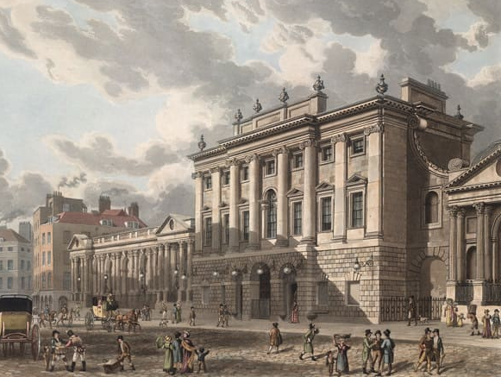
Capitalist crises
“It is enough to mention the commercial crises that by their periodical return put the existence of the entire bourgeois society on its trial, each time more threateningly. In these crises, a great part not only of the existing products, but also of the previously created productive forces, are periodically destroyed. In these crises, there breaks out an epidemic that, in all earlier epochs, would have seemed an absurdity — the epidemic of over-production. Society suddenly finds itself put back into a state of momentary barbarism; it appears as if a famine, a universal war of devastation, had cut off the supply of every means of subsistence; industry and commerce seem to be destroyed…”

Slide 9
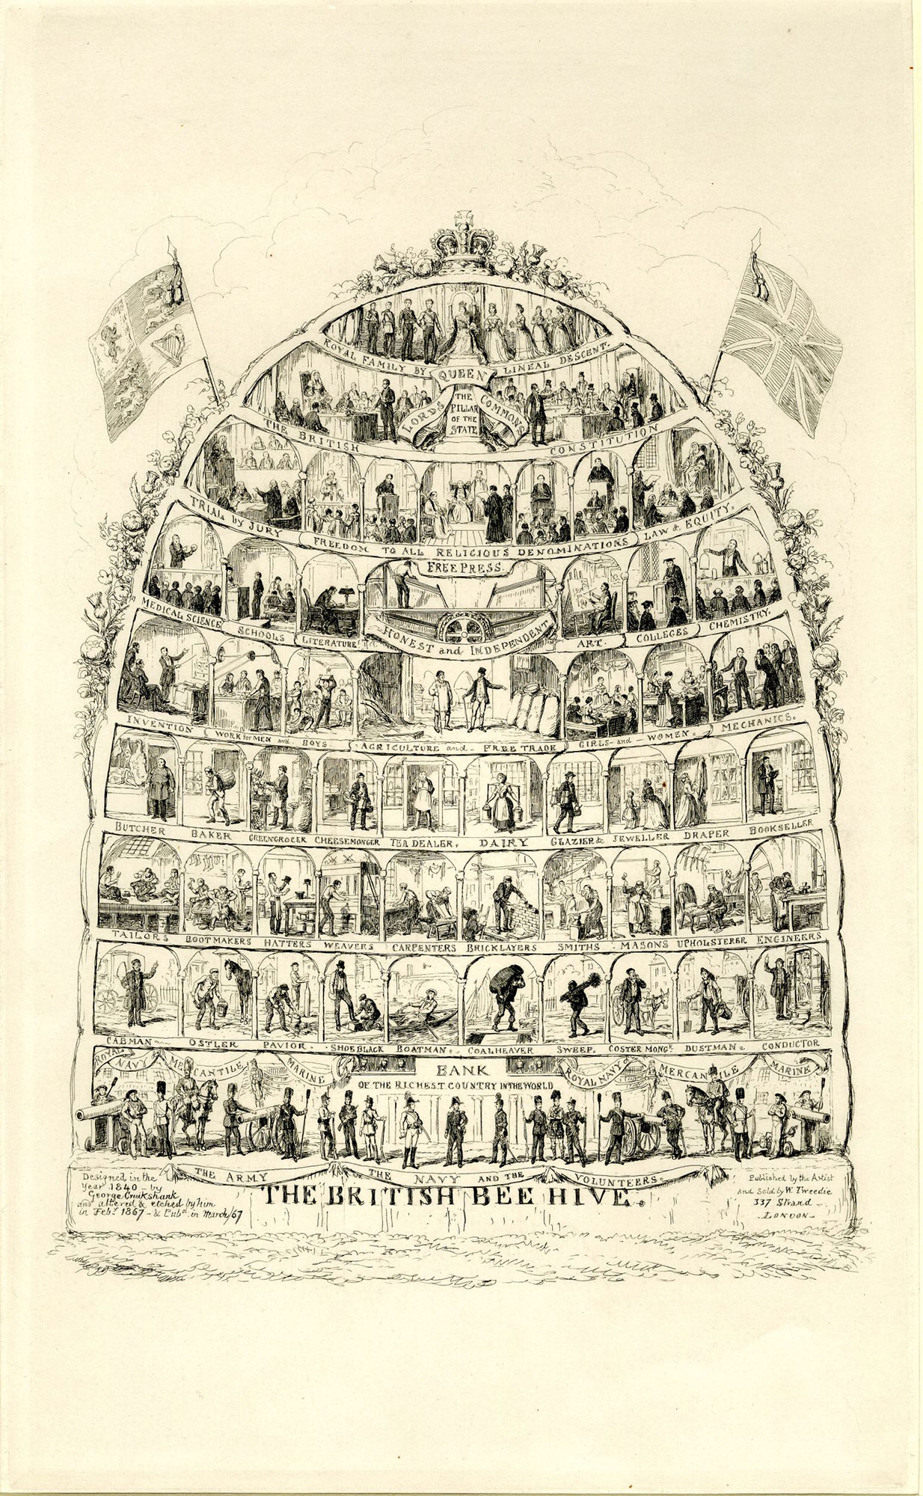
Myths about the middle class
“Our epoch, the epoch of the bourgeoisie, possesses, however, this distinct feature: it has simplified class antagonisms. Society as a whole is more and more splitting up into two great hostile camps.”
“The small intermediate strata existing up to now – the small industrials, merchants, and rentier, the artisans and peasants – all these classes sink down into the proletariat…” [HD]
“The other classes decay and finally disappear [go under] in the face of modern industry.”
III: “In countries where modern civilisation has become fully developed, a new class of petty bourgeois has been formed, fluctuating between proletariat and bourgeoisie, and ever renewing itself as a supplementary part of bourgeois society.”

Slide 10
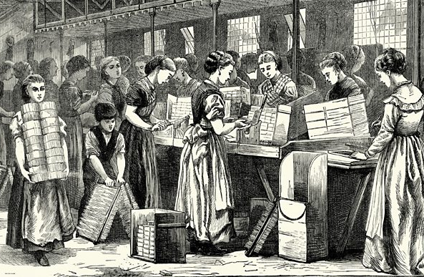
The proletariat
“In proportion as the bourgeoisie, i.e., capital, is developed, in the same proportion is the proletariat, the modern working class, developed — a class of labourers, who live only so long as they find work, and who find work only so long as their labour increases capital.”
“By proletariat, the class of modern wage labourers who, having no means of production of their own, are reduced to selling their labour power in order to live.”
Engels (1888) Note to the English edition of the Communist Manifesto. MECW 6: 482

Slide 11
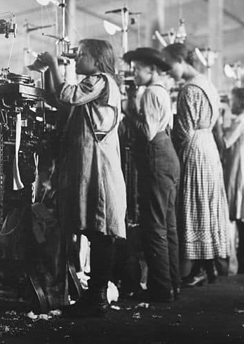
Waged labour
“These labourers, who must sell themselves piecemeal, are a commodity, like every other article of commerce, and are consequently exposed to all the vicissitudes of competition, to all the fluctuations of the market.”
“The cost of production of a workman is restricted, almost entirely, to the means of subsistence that he requires for maintenance… the average price of wage-labour is the minimum wage, i.e., that quantum of the means of subsistence which is absolutely requisite to keep the labourer in bare existence as a labourer.”
“The value of labour power is constituted from two elements, one of which is merely physical, the other historical or social... The matter resolves itself into a question of the respective powers of the combatants.”
Marx (1865) Value, Price and Profit. MECW 20: 144, 146

Slide 12
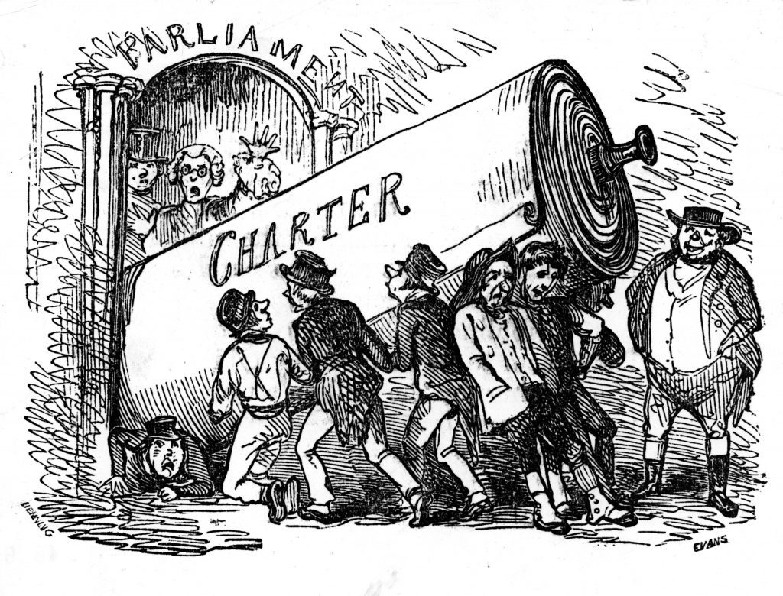
Labour movement
“Thereupon, the workers begin to form combinations (trades’ unions) against the bourgeois; they club together in order to keep up the rate of wages; they found permanent associations in order to make provision beforehand for these occasional revolts.”
“This organisation of the proletarians into a class, and, consequently into a political party, is continually being upset again by the competition between the workers themselves. But it ever rises up again, stronger, firmer, mightier.”

Slide 13
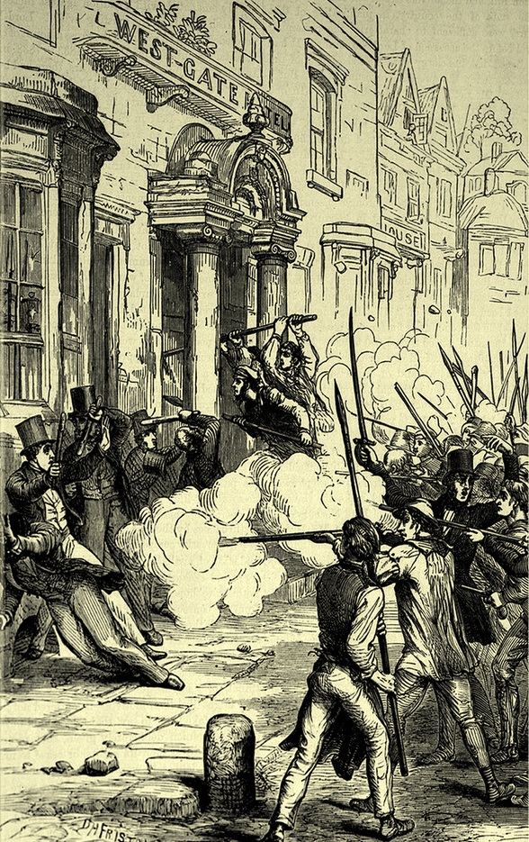
The revolutionary class
“The proletariat alone is a really revolutionary class.”
“The proletarian movement is the self-conscious, independent movement of the immense majority, in the interest of the immense majority. The proletariat, the lowest stratum of our present society, cannot stir, cannot raise itself up, without the whole superincumbent strata of official society being sprung into the air.”
“In depicting the most general phases of the development of the proletariat, we traced the more or less veiled civil war, raging within existing society, up to the point where that war breaks out into open revolution, and where the violent overthrow of the bourgeoisie lays the foundation for the sway of the proletariat.”

Slide 14
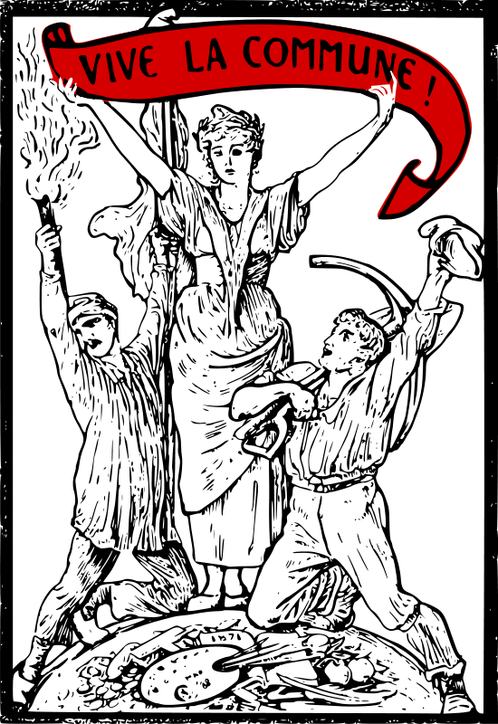
Working class self-emancipation
“What the bourgeoisie therefore produces, above all, are its own grave-diggers. Its fall and the victory of the proletariat are equally inevitable.”
“The emancipation of the working class must be the act of the working class itself… the exploited and oppressed class — the proletariat — cannot attain its emancipation… without, at the same time, and once and for all, emancipating society at large from all exploitation, oppression, class distinction, and class struggles.”
Engels (30 January 1888) Preface to English edition of the Communist Manifesto. MECW 26: 517

Slide 15
Discussion
Questions
1) What is class? Why is class struggle the driving force of human history?
2) Why does Marx believe capitalism is progressive? Is it still progressive?
3) What is the nature of the capitalist state?
4) How does the proletariat differ from slaves and peasants?
5) Why is the working class the revolutionary class?
6) Why is the organised labour movement central?
7) Was Marx wrong about the middle class?
Concepts
• Classes and class struggle
• The bourgeoisie
• The state
• The middle class
• The working class
• The labour movement
• Crises
• Wages
• Lumpenproletariat
• Peasants
• Ecology

