Slide 1
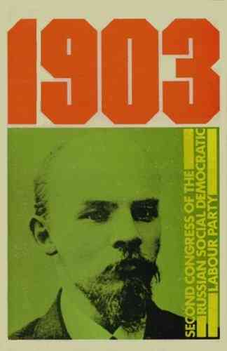
Session 7: What was done with WITBD?
Second Congress of the RSDLP (17 July and 10 August 1903)
The first week was held in Brussels, then London
43 delegates from 26 organisations, 14 others with speaking rights
Iskra supporters held the majority of mandates
Lenin, Plekhanov, Martov, Trotsky, Deutsch, Axelrod and Zasulich
The Economists – Vladimir Akimov and Aleksandr Martynov
Bundists – Arkadi Kremer, Mark Liber and Vladimir Medem
Eight of those present were women.
Bolshevik-Menshevik split
Definition of membership: Lenin (23-28 votes), Martov (28-22-1)
Editorial board: Plekhanov (23), Martov (22), Lenin (20) and Koltsov (3)
Central committee: 24 votes – Glebov, Krzhizhanovsky and Lenznik.

Slide 2
Martynov vs Iskra 1903
“Thus, history gives us the right to say: first, all modern socialism is the product of the working class, though materials for it had already been made ready by the bourgeois democrats; and, secondly, in the elaboration of modern socialism, sections of the working class which differed in their levels of consciousness arrived in practice, gropingly, at the separate tasks and solutions which their ideologists discovered, synthesised and grounded theoretically. These propositions are of enormous importance. They contradict the thesis put forward by Comrade Lenin in his pamphlet What Is To Be Done?…”
Martynov (21 July 1903) Pearce, 1903: RSDLP Second Congress. 1978: 148-149
“But if you eliminate the ‘bacillus’, then you are left with a uniform unconscious mass, into which consciousness has to be injected from without… [Lenin] develops that very idea that broad socialist consciousness can be introduced only from outside the limits of the direct struggle for improving the conditions which govern the sale of labour-power.”
Plekhanov (22 July 1903) Pearce, RSDLP Second Congress. 1978: 158-159
“We all know now that the 'economists' bent the stick in one direction. In order to make the stick straight it was necessary to bend the stick in the other direction, and that is what I did. I am sure that Russian Social Democracy will always straighten the stick that is bent by any kind of opportunism, and that our stick will therefore always be straight as possible and as ready as possible for action.”
Lenin (22 July 1903) Pearce, Second Congress of the RSDLP. 1978: 169-170

Slide 3
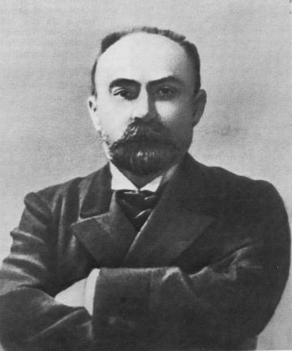
Plekhanov
In September 1903, the minority founded the Menshevik faction.
In October they convened the second congress of the League of Russian Revolutionary Social-Democracy Abroad, seeking to circumvent the decisions of the second RSDLP congress.
In October-November 1903, Plekhanov defected to the Mensheviks, who had been boycotting Iskra since the congress. Lenin resigned from the editorial board. Plekhanov published Iskra on his own for one issue and then with an editorial board including the three former members, now Mensheviks, who had been voted off at the congress.
“When I read the manuscript of the pamphlet, What Is To Be Done?, I immediately said to Lenin and to other members of our Editorial Board that I saw quite enough theoretical mistakes in it. As regards ‘spontaneity’ and ‘consciousness’ in particular… [Lenin] not only failed to let go of sticks bent by him in the polemic with the ‘Economists’, but sat on the top of that curved stick and revealed the most unmistakeable intention to travel on it… I will start with a firm conviction of the need to liquidate the ‘fourth’ period of our Party’s history, having thrown Lenin’s ‘over-bent stick’ onto the rubbish heap.”
Plekhanov (25 July-1 August 1904) The Working Class and the Social-Democratic Intelligentsia. Mullin 2016: 571-72

Slide 4
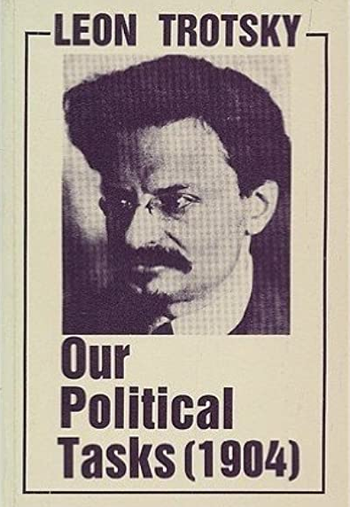
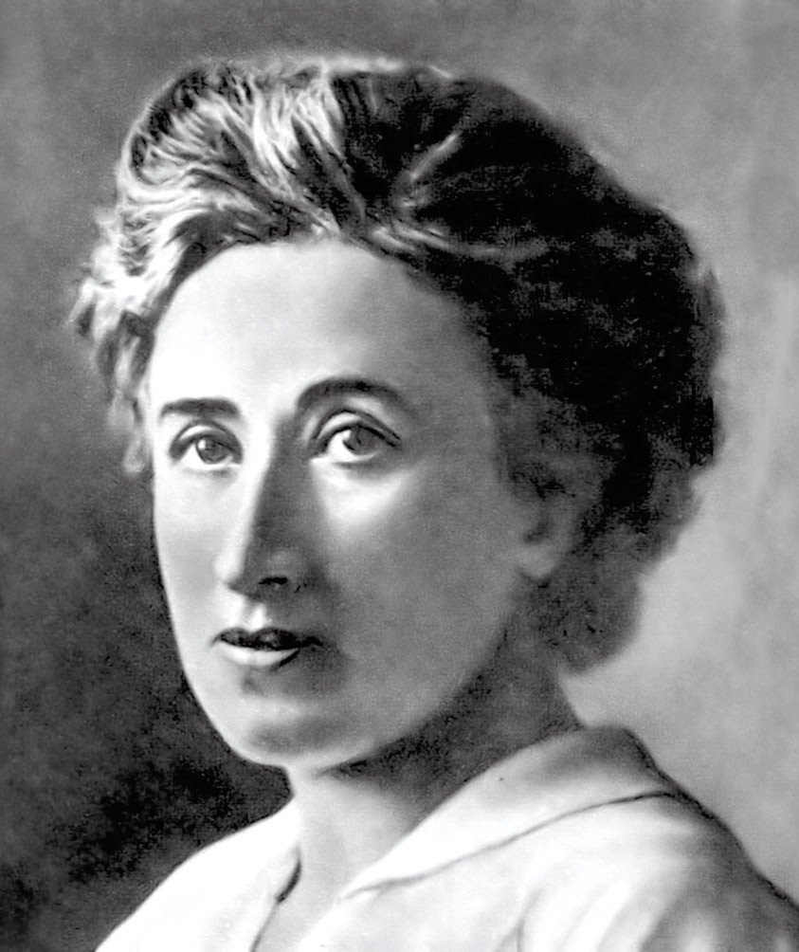
Trotsky and Luxemburg
“In the internal politics of the Party these methods lead, as we shall see below, to the Party organisation “substituting” itself for the Party, the Central Committee substituting itself for the Party organisation, and finally the dictator substituting himself for the Central Committee.”
Trotsky (1904) Our Political Tasks. 1978: 77
“The establishment of centralisation in social democracy on these two principles-on the blind submission of all party organisations and their activity, down to the smallest detail, to a central authority that alone thinks, acts and decides for everyone, and also on the strict separation of the organised nucleus of the party from its surrounding revolutionary milieu, as Lenin advocates – therefore seems to us to be a mechanical transposition of the organisational principles of the Blanquist movement of conspiratorial circles to the social democratic movement of the working masses.”
Rosa Luxemburg (1904) Organisational Questions of the Russian Social Democracy. Die neue Zeit. 2004: 252-53

Slide 5
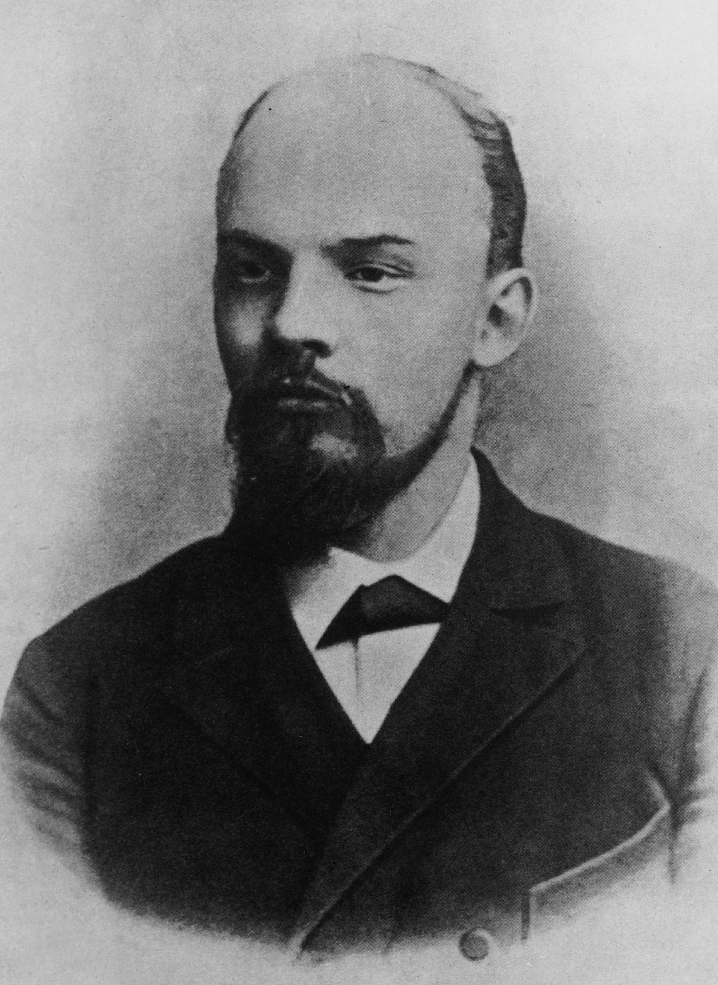
Lenin
“It is necessary to include in the party rules guarantees of the rights of any minority...”
Lenin (August 1904) To the Party. LCW 7: 460
“Luxemburg fathers on me that all the conditions already exist in Russia for forming a large and extremely centralised workers’ party... Nowhere in my book did I voice such an idea.”
Lenin (September 1904) Reply by N. Lenin to Rosa Luxemburg. LCW 7: 474, 476
“Under conditions of political freedom, our Party can and will be built entirely on the elective principle. Under the autocracy this is impracticable...”
Lenin (February 1905) Draft Resolutions for Third Congress of RSDLP. LCW 8: 196
“The working class is instinctively, spontaneously Social-Democratic, and more than ten years of work put in by Social-Democracy has done a great deal to transform this spontaneity into consciousness.”
Lenin (10 November 1905) The Reorganisation of the Party’, LCW 10: 31-32
The basic mistake made by people who polemicise with What is to be Done? at the present time is that they tear this production completely out of specific historical context… What Is To Be Done? is a summary of Iskra tactics and Iskra organisational policy in 1901 and 1902… no more and no less.”
Lenin (September 1907) Preface to the Collection Twelve Years. LCW 13: 102

Slide 6
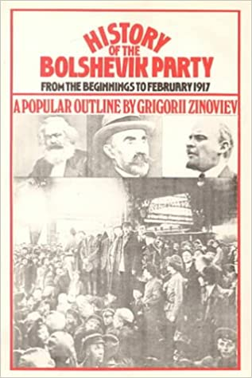
Zinoviev
“In the book What Is to Be Done, Lenin stated and solved in a revolutionary spirit all the vexatious questions of the movement of that epoch. And for many months and years this book was challenging thought, was the centre of raging passions, was the subject of controversy, and ultimately led to the formation of a split into two irreconcilable camps.”
Zinoviev (1918) Lenin. Fourth International, January, 1945: 8
“Besides Iskra, an exceptional role was played by Comrade Lenin’s book What Is To Be Done? which was published in the spring of 1902. This was not merely a book: it was a book marking an era. It drew up a two-year account of the work of Iskra. At the same time it was handbook and gospel for all revolutionary Marxist activists of the time. And it was only in 1903 that the Mensheviks, having seen the conclusions which had been drawn from this book, began, in retrospect and through a magnifying glass, to seek disagreements with it.”
Zinoviev, (1923) History of the Bolshevik Party. 1973: 77

Slide 7
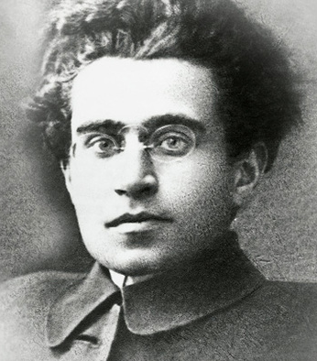
Gramsci
“The struggle of the proletariat against capitalism unfurls on three fronts: the economic, the political, and the ideological.
“The economic struggle has three phases: i) Of resistance against capitalism – i.e. the phase of elemental trade unionism. ii) Of an offensive against capitalism to win workers’ control over production. iii) Of the fight for the elimination of capitalism by means of socialisation.
“The political struggle also has three principal phases: i) The fight to reign in the power of the bourgeois through a parliamentary state… ii) The fight for the conquest of power and for the creation of a workers’ state... iii) The phase of the dictatorship of the proletariat...
“A conscious ‘ideological’ element is necessary. This entails an understanding of the conditions in which the class is fighting, of the social relations in which workers live, of the fundamental tendencies that operate within these social relationships, and of the development of society (driven by the irreconcilable antagonisms at its heart), etcetera.”
Antonio Gramsci (April-May 1925) An introduction to the first course of the party school. Selections from Political Writings, 1921-26. 1978: 287-88

Slide 8
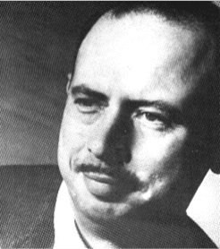
Shachtman
“Lenin’s much-disputed What is to be Done? held up, as is known, the German social-democracy and its leader, Bebel, as models for the Russian movement…
“The ideas contained in What is to be Done? which should still be read by revolutionists everywhere – and it can be read with the greatest profit – cannot, therefore, be understood without bearing in mind the specific conditions and problems of the Russian movement of the time. That is why Lenin, in answer to a proposal to translate his brochure for the non-Russian parties, told Max Levien in 1921:
‘That is not desirable; the translation must at least be issued with good commentaries, which would have to be written by a Russian comrade very well acquainted with the history of the Communist Party of Russia, in order to avoid false application.’
Shachtman, Lenin and Rosa Luxemburg, New International, IV, 5, May 1938: 142-43

Slide 9
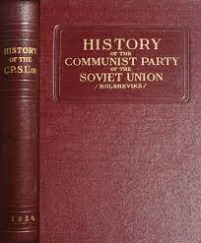
Stalin’s Short Course (1938)
“The historic significance of this celebrated book [What Is To Be Done] lies in the fact that in it Lenin:
1) For the first time in the history of Marxist thought, laid bare the ideological roots of opportunism, showing that they principally consisted in worshipping the spontaneous working-class movement and belittling the role of Socialist consciousness in the working-class movement;
2) Brought out the great importance of theory, of consciousness, and of the Party as a revolutionising and guiding force of the spontaneous working-class movement;
3) Brilliantly substantiated the fundamental Marxist thesis that a Marxist party is a union of the working-class movement with Socialism;
4) Gave a brilliant exposition of the ideological foundations of a Marxist party.
“The theoretical theses expounded in What is To Be Done? later became the foundation of the ideology of the Bolshevik Party.”
Stalin, History of the Communist Party of the Soviet Union. 1938: 37-38

Slide 10
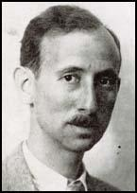
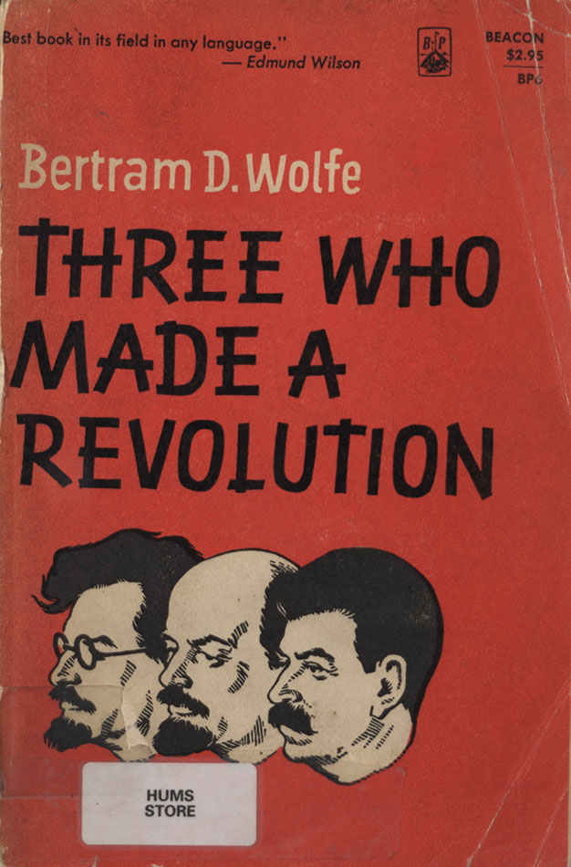
Cold War - Bertram Wolfe
“The real issue [was] between ‘Economists’ and Marxists, then between Mensheviks and Bolsheviks, then between Workers Opposition and Lenin, between Tomsky and Stalin, changing forms of the protean battle between Westerniser and Slavophile. One path led closer to the parties and trade unions of the West, which were democratically organised, comfortably adapted to the sizeable legality permitted them, and long since devoid of insurrectionary spirit except as a banner for festal occasions. The other led to concentration on conspiracy and insurrection under the leadership of a self-selected, rigidly centralised, secret and conspirative band of revolutionary intellectuals under a self-appointed leader, formed on the pattern of the early 'professional revolutionaries' of the Narodnaya Volya.” Bertram Wolfe (1948) Three Who Made a Revolution. 1964: 160-61
“In two pamphlets, and a number of articles published between 1902 and 1904, Lenin had been hammering away at his new organisation plan for a ‘party of a new type’, that is, one differing fundamentally from all previous Marxian parties, whether those founded while Marx and Engels were alive, or since…” Bertram Wolfe, ‘Introduction’, in Rosa Luxemburg, The Russian Revolution and Leninism or Marxism. 1961: 11

