Slide 1
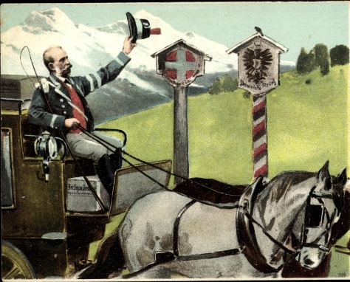
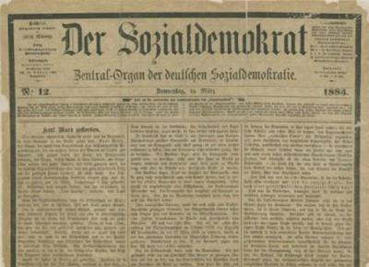
Session 6: Newspapers and party building
The “red postmaster”, Julius Motteler supervised and elaborated the distribution system used to smuggle Der Sozialdemokrat into Germany from Switzerland when the SPD was outlawed (1878-90).

Slide 2
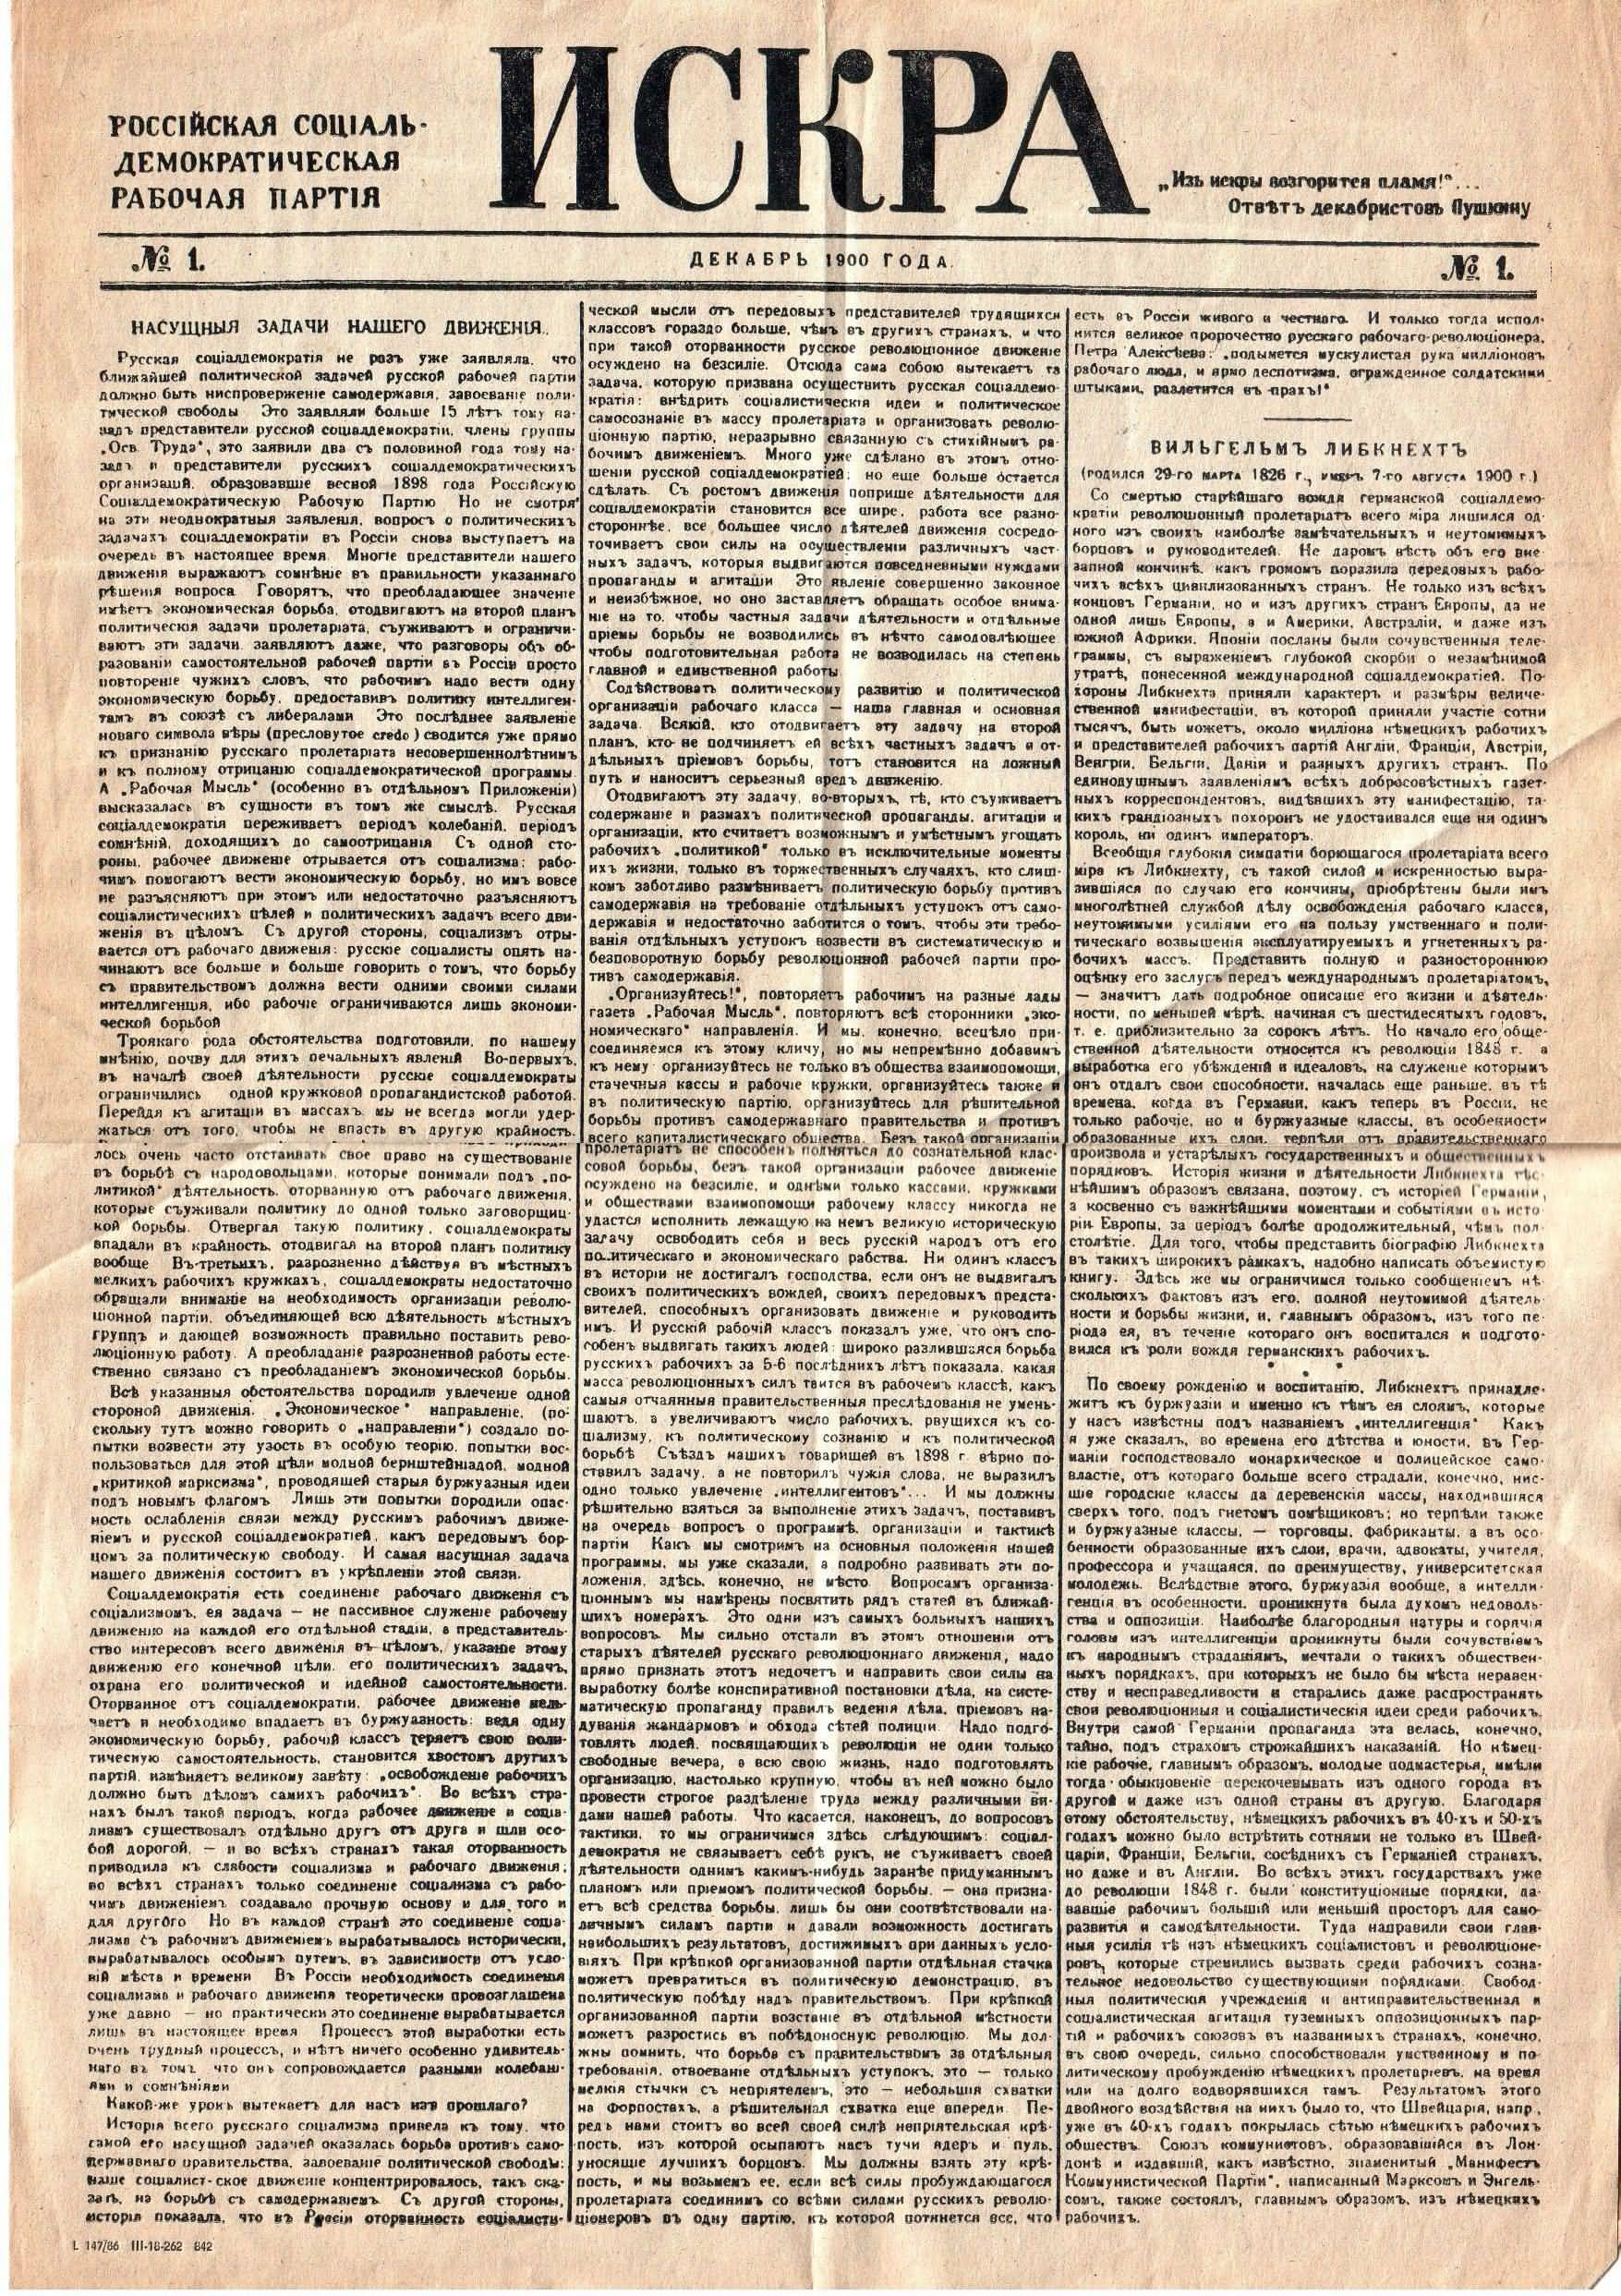
Session 6: Newspapers and party building
“Unless we train strong political organisations in the localities, even an excellently organised all-Russia newspaper will be of no avail. This is incontrovertible. But the whole point is that there is no other way of training strong political organisations except through the medium of an all-Russia newspaper.”
Lenin (1902) What is to be Done? LCW 5: 499
“When bricklayers lay bricks in, various parts of an enormous, unprecedentedly large structure, is it “paper” work to use a line to help them find the correct place for the bricklaying; to indicate to them the ultimate goal of the common work; to enable them to use, not only every brick, but even every piece of brick which, cemented to the bricks laid before and after it, forms a finished, continuous line? And are we not now passing through precisely such a period in our Party life when we have bricks and bricklayers, but lack the guide line for all to see and follow?”
Lenin (1902) What is to be Done? LCW 5: 501

Slide 3
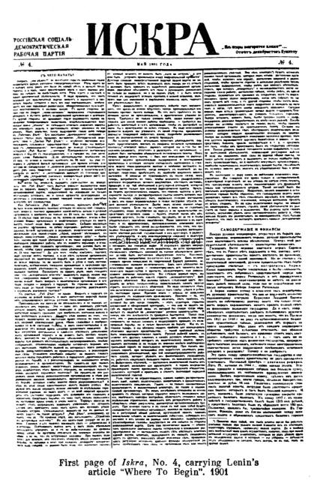
Collective propagandist, agitator, organiser
“Another comparison: ‘A newspaper is not only a collective propagandist and a collective agitator, it is also a collective organiser. In this respect it may be compared to the scaffolding erected round a building under construction; it marks the contours of the structure and facilitates communication between the builders, permitting them to distribute the work and to view the common results achieved by their organised labour.’ [Where to Begin, 1901]
Does this sound anything like the attempt of an armchair author to exaggerate his role? The scaffolding is not required at all for the dwelling; it is made of cheaper material, is put up only temporarily, and is scrapped for firewood as soon as the shell of the structure is completed. As for the building of revolutionary organisations, experience shows that sometimes they may be built without scaffolding, as the seventies showed. But at the present time we cannot even imagine the possibility of erecting the building we require without scaffolding.”
Lenin (1902) What is to be Done? LCW 5: 502-03

Slide 4

Worker intellectuals
“enlightened workers”
Lenin (1902) What is to be Done? LCW 5: 500
“The task of the ‘Workers’ Library’… amounts principally to explaining to the worker intelligentsia its tasks and the conditions through which they can best be accomplished.”
Plekhanov and Axelrod (1884) From the Publishers of the ‘Workers’ Library’. Harding 1983: 71
“The workers socialists and worker ‘intellectuals’ – exist and that you are preparing to take into your own hands the political awakening of the oppressed and deprived masses.”
Axelrod (1893) The Tasks of the Worker Intelligentsia in Russia. Harding 1983: 115
“This ‘working-class intelligentsia’ already exists in Russia, and we must make every effort to ensure that its ranks are regularly reinforced, that its lofty mental requirements are met and that leaders of the Russian Social-Democratic Labour Party come from its ranks.”
Lenin (1899) A Retrograde Trend in Russian Social-Democracy. LCW 4: 280-81

Slide 5
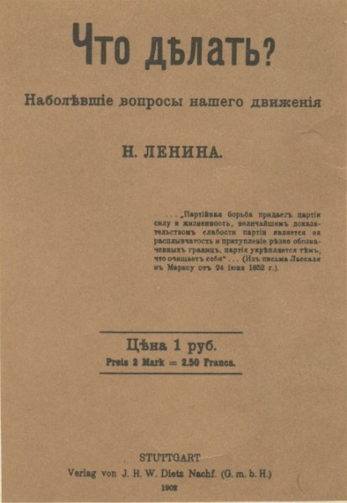
Session 6: Newspapers and party building
Key ideas
Revolutionary newspaper
Collective propagandist, agitator and organiser
Worker intellectuals
Questions
1) Why does Lenin put such emphasis on the role of a newspaper?
2) What functions does the revolutionary socialist paper have?
3) What does Lenin mean by “enlightened workers”?
4) At what stage was the Russian socialist movement when Lenin wrote WITBD?

Slide 6
Session 6: Key passages
“The history of Russian Social-Democracy can be distinctly divided into three periods:
“The first period embraces about ten years, approximately from 1884 to 1894. This was the period of the rise and consolidation of the theory and programme of Social-Democracy. The adherents of the new trend in Russia were very few in number. Social-Democracy existed without a working-class movement, and as a political party it was at the embryonic stage of development.
“The second period embraces three or four years—1894-99. In this period Social-Democracy appeared on the scene as a social movement, as the upsurge of the masses of the people, as a political party. This is the period of its childhood and adolescence... Trained in this struggle, Social-Democrats went into the working-class movement without “for a moment” forgetting either the theory of Marxism, which brightly illumined their path, or the task of overthrowing the autocracy. The formation of the Party in the spring of 1898 was the most striking and at the same time the last act of the Social-Democrats of this period.
“The third period, as we have seen, was prepared in 1897 and it definitely cut off the second period in 1898 (1898-?). This was a period of disunity, dissolution, and vacillation...”
Lenin (1902) What is to be Done? LCW 5: 517-18

