Slide 1
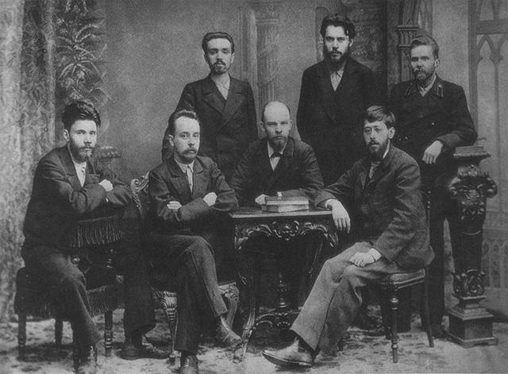
Session 5: Professional revolutionaries
“Such workers, average people of the masses, are capable of displaying enormous energy and self-sacrifice in strikes and in street, battles with the police and the troops, and are capable (in fact, are alone capable) of determining the outcome of our entire movement — but the struggle against the political police requires special qualities; it requires professional revolutionaries. And we must see to it, not only that the masses “advance” concrete demands, but that the masses of the workers “advance” an increasing number of such professional revolutionaries. Thus, we have reached the question of the relation between an organisation of professional revolutionaries and the labour movement pure and simple…
“And we will succeed in doing this, because the spontaneously awakening masses will also produce increasing, numbers of “professional revolutionaries” from their own ranks.”
Lenin (1902) What is to be Done? LCW 5: 450-51

Slide 2
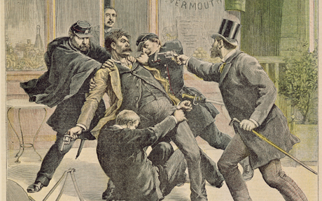
Amateur
“Our worst sin with regard to organisation consists in the fact that by our primitiveness we have lowered the prestige of revolutionaries in Russia.
A person who is flabby and shaky on questions of theory, who has a narrow outlook, who pleads the spontaneity of the masses as an excuse for his own sluggishness, who resembles a trade union secretary more than a spokesman of the people, who is unable to conceive of a broad and bold plan that would command the respect even of opponents, and who is inexperienced and clumsy in his own professional art — the art of combating the political police — such a man is not a revolutionary, but a wretched amateur!”
Lenin (1902) What is to be Done? LCW 5: 466

Slide 3
Vertrauenspersonen or professional union officials
At its 1871 Dresden congress, the SDAP established the institution of the Vertrauensmann (“trusted person”)… During the ban on the SPD, the Vertrauensmänner smuggled packets of Der Sozialdemokrat newspaper into the country…
The 1894 party congress created a Vertrauenspersonen system as the basis of women’s representation. Clara Zetkin and Ottilie Baader organised the first women’s Vertrauenspersonen conference in 1900.
Gary Steenson, ‘Not One Man! Not One Penny!’ German Social Democracy, 1863-1914. 1981: 27-28, 39, 151
Lenin seems to have acquired the language of professionalism from Sidney and Beatrice Webb's Industrial Democracy (1897). Lenin and Krupskaia translated the original into Russian…
In the early trade union movement, the local union was a ‘primitive democracy’. As the division of labour increased, there emerged the ‘professional civil servant’…
The Webbs recognised that professionalisation of trade union also created problems… ‘To balance the professional civil servant we have... the professional representative.’ The latter ‘has become a professional expert in ascertaining and representing the desires of his constituents’.
Robert Mayer, Lenin and the concept of the professional revolutionary, History of Political Thought, 14, 2, 1993: 253

Slide 4
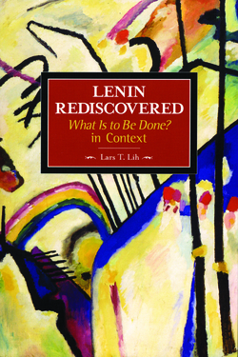
“revolutionary by trade”
Lenin’s most famous coinage in WITBD is revoliutsioner po professii or professional’nyi revoliutsioner. In Russian, at least when Lenin wrote, professiia meant ‘trade’, that is, a specialised branch of economic activity.
‘By trade’ connotes a skill which can be learnt and is both a source of respect and pride. Those with this skill would make no distinction between those of a worker or intelligentsia background. The ultimate aim of the metaphor is to portray the revolutionary as part of the workers’ world, ‘a fellow skilled labourer in the great factory of revolution’.
Lenin had never used ‘revolutionary by trade’ previously… In fact the term seems to have been a last-minute improvisation prompted by Nadezhdin…
Kustarichestvo was a Lenin coinage. Translators have rendered it as ‘primitive methods’, ‘primitiveness’, ‘amateurism’... I translate kustarichestvo as ‘artisanal limitations’...

Slide 5
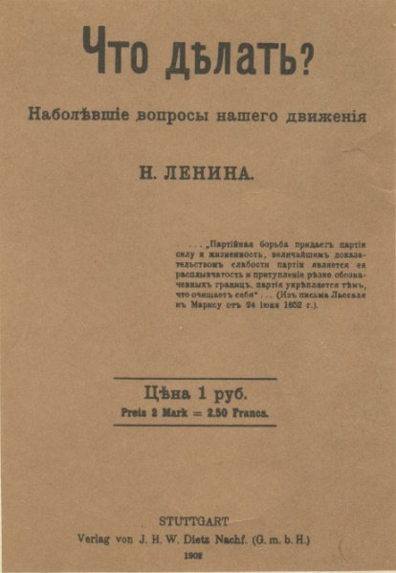
Session 5: Professional revolutionaries
Key ideas
professional revolutionary
amateurism
demagogues
conspiracy
Questions
1) What failures does Lenin identify among the revolutionary socialists?
2) What does Lenin mean by a “professional revolutionary”?
3) Did Lenin believe the socialist movement should be led by intellectuals?
4) Was Lenin in favour of conspiracy?
5) How does underground work limit democratic procedures?

Slide 6
Session 5: Key passages
“It would be extremely naive indeed, therefore, to fear the charge that we Social-Democrats desire to create a conspiratorial organisation.”
Lenin (1902) What is to be Done? LCW 5: 476
A concise definition of konspiratsiia was “the fine art of not getting arrested”
Lenin also argues that formal democratic institutions such as elections within local organisations are dangerous because they violate konspiritsiia. Elections and other kinds of formal rules allow the police to infiltrate and to locate its leaders… Lenin also used konspiritsiia considerations as an additional argument against wasting time and resources on local underground newspapers.
Lih 2005: 434-36, 447-450
“demagogues are the worst enemies of the working class.”
Lenin (1902) What is to be Done? LCW 5: 463

