Slide 1
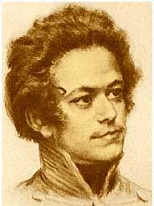
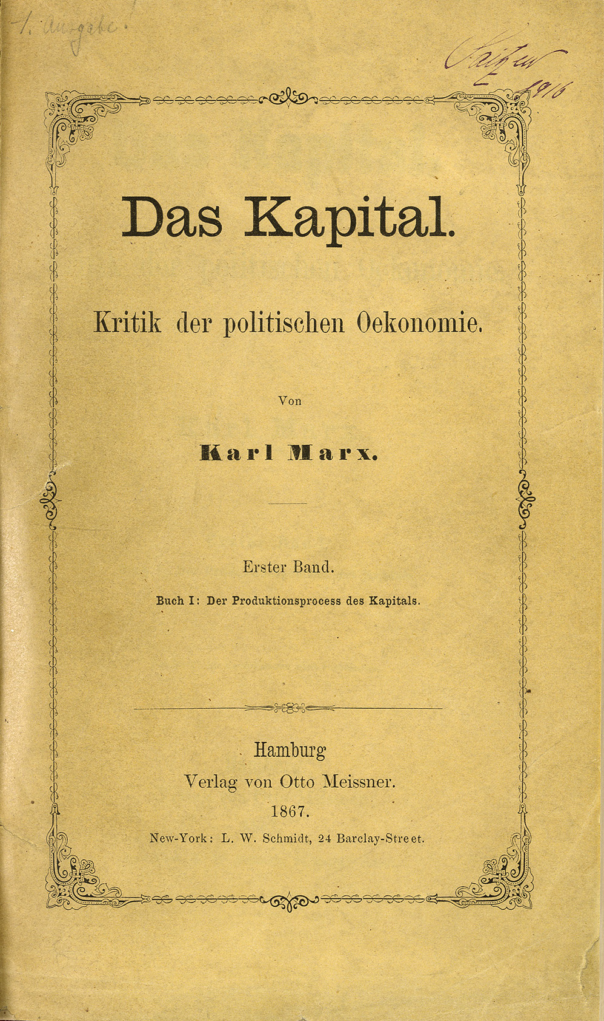
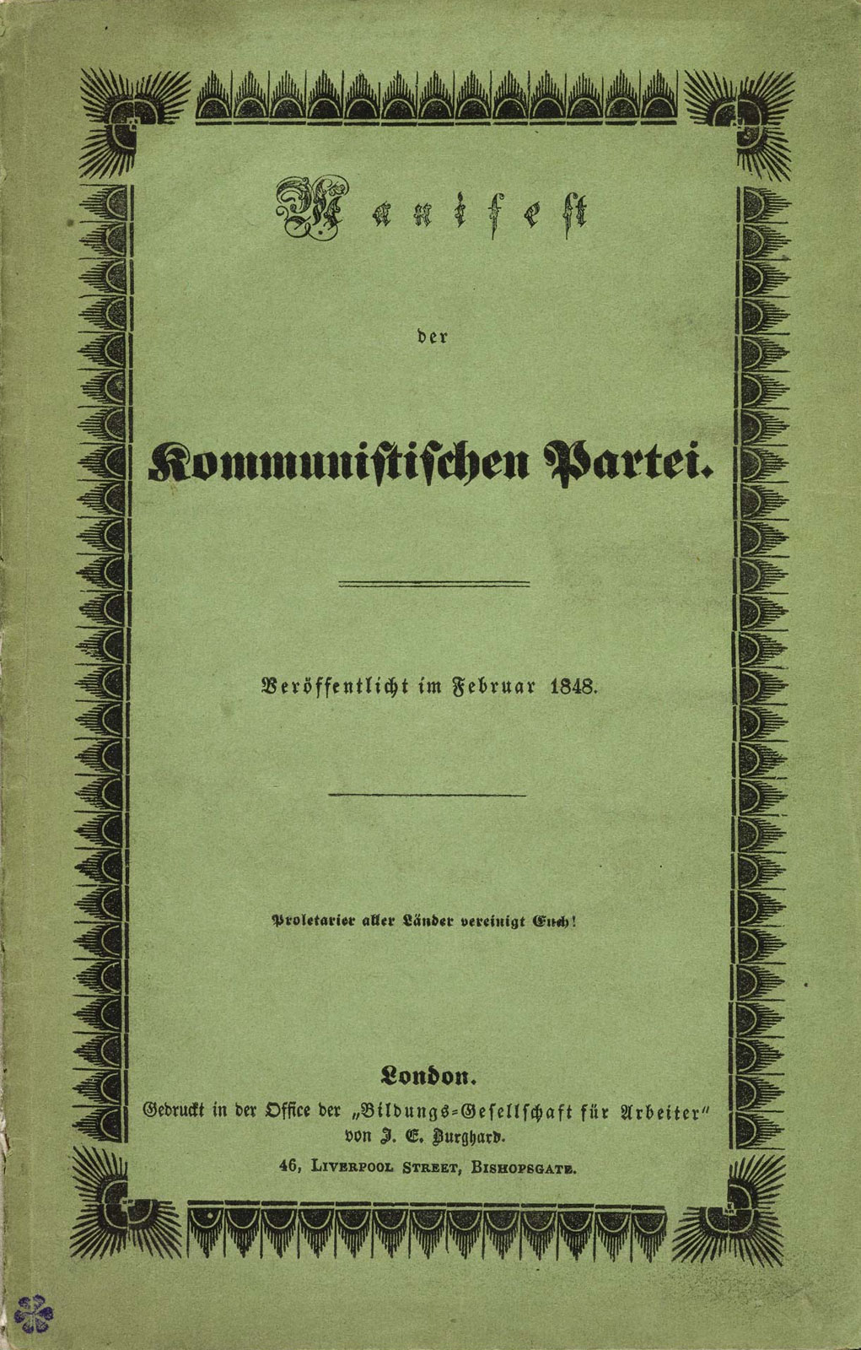
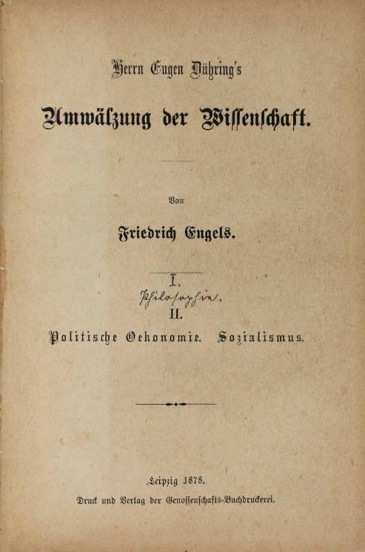
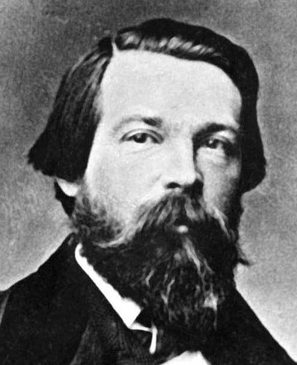
Session 2: Germany – revolutionary theory

Slide 2
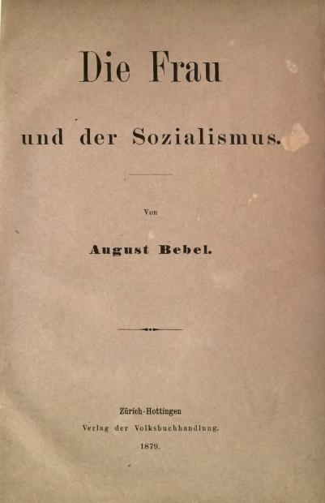
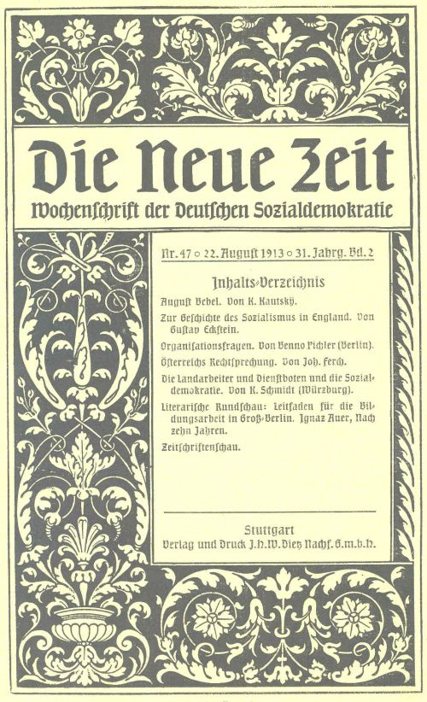
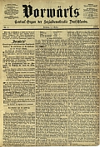
SPD: freedom of criticism
Wilhelm Liebknecht (1896): “The central sheet belongs to the entire party and if various currents prevail in the party... I do not consider myself entitled to damn or excommunicate deviating opinions from my editorial desk.”

Slide 3
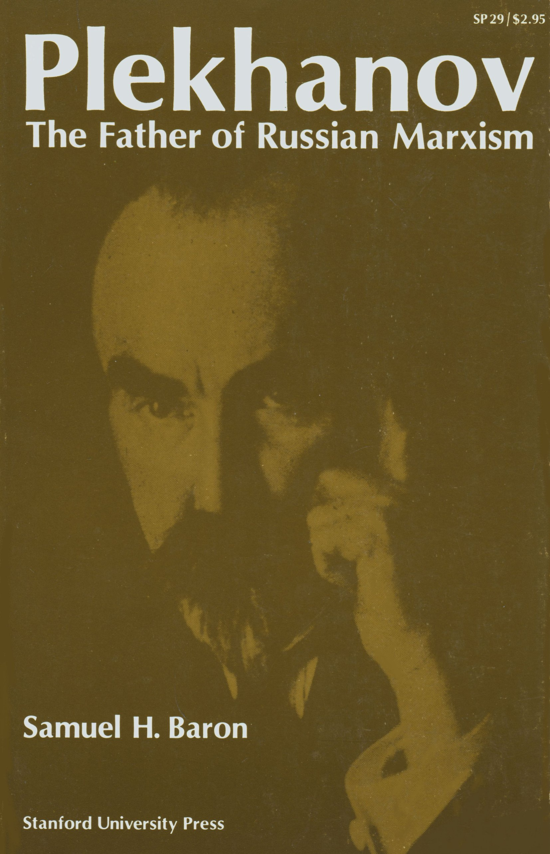

Russia: revolutionary theory
Socialism and Political Struggle (1883)
Our Differences (1884)
Speech at the Second International Socialist Congress (1889)
The Tasks of the Social Democrats in the Struggle against the Famine in Russia (1891)
What Should We Thank Him For? (1898)
Vademecum for the Editorial Board of ‘Rabochee Delo’ (1900)

Slide 4
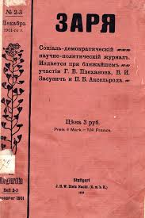
Revolutionary theory and debate
“Party struggles lend a party strength and vitality; the greatest proof of a party’s weakness is its diffuseness and the blurring of clear demarcations; a party becomes stronger by purging itself...” (From a letter of Lassalle to Marx, of June 24, 1852)
Lenin (1902) What is to be Done? LCW 5: 346
Before we can unite, and in order that we may unite, we must first of all draw firm and definite lines of demarcation. Otherwise, our unity will be purely fictitious…
It is understandable, therefore, that we do not intend to make our publication a mere storehouse of various views. On the contrary, we shall conduct it in the spirit of a strictly defined tendency... Open polemics, conducted in full view of all Russian Social-Democrats and class-conscious workers, are necessary and desirable in order to clarify the depth of existing differences, in order to afford discussion of disputed questions from all angles… we regard one of the drawbacks of the present-day movement to be the absence of open polemics between avowedly differing views, the effort to conceal differences on fundamental questions.
Lenin (September 1900) Declaration of the Editorial Board of Iskra. LCW 4: 354-55

Slide 5
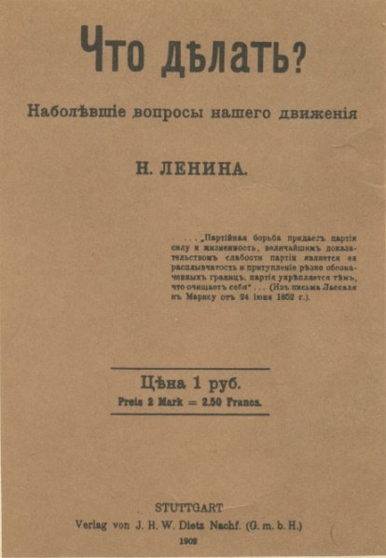
Session 2: Revolutionary theory
Key ideas
Criticism
Opportunism
Revolutionary theory
Ideological front of the class struggle
Questions
1) Why does the working class movement need revolutionary theory?
2) Why does Lenin elevate the ideological front of the class struggle?
3) Why does Lenin seem so hostile towards ‘criticism’?
4) What does Lenin’s metaphor of the swamp signify about his opponents?

Slide 6
Session 2: Key passages
“He who does not deliberately close his eyes cannot fail to see that the new “critical” trend in socialism is nothing more nor less than a new variety of opportunism. And if we judge people, not by the glittering uniforms they don or by the high-sounding appellations they give themselves, but by their actions and by what they actually advocate, it will be clear that “freedom of criticism” means’ freedom for an opportunist trend in Social-Democracy, freedom to convert Social-Democracy into a democratic party of reform, freedom to introduce bourgeois ideas and bourgeois elements into socialism.” Lenin (1902) What is to be Done? LCW 5: 354-55
“We are marching in a compact group along a precipitous and difficult path, firmly holding each other by the hand. We are surrounded on all sides by enemies, and we have to advance almost constantly under their fire. We have combined, by a freely adopted decision, for the purpose of fighting the enemy, and not of retreating into the neighbouring marsh [swamp], the inhabitants of which, from the very outset, have reproached us with having separated ourselves into an exclusive group and with having chosen the path of struggle instead of the path of conciliation.” Lenin (1902) What is to be Done? LCW 5: 355
“Without revolutionary theory there can be no revolutionary movement.” Lenin (1902) What is to be Done? LCW 5: 369
“Engels recognises, not two forms of the great struggle of Social Democracy (political and economic), as is the fashion among us, but three, placing the theoretical struggle on a par with the first two.” Lenin (1902) What is to be Done? LCW 5: 370
“For the first time since a workers’ movement has existed, the struggle is being conducted pursuant to its three sides – the theoretical, the political, and the practical-economic (resistance to the capitalists) – in harmony and in its interconnections, and in a systematic way.” Engels (1874) Addendum to The Peasant War in Germany MECW 23, 1988: 630-31

