Slide 1
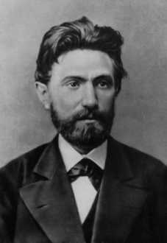
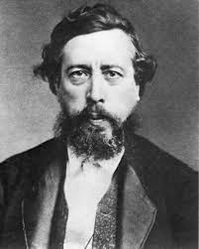
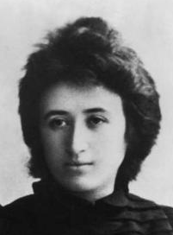
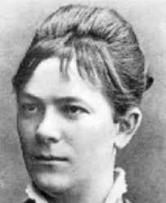
Session 1: German SPD model
Year | Name | Members
1869 | Sozialdemokratische Arbeiterpartei (SDAP) | 10,000
1875 | Sozialistische Arbeiterpartei Deutschlands (SAPD) | 25,000
1890 | Sozialdemokratische Partei Deutschlands (SPD) | 290,000
Year | Votes | % | Seats
1871 | 124,655 | 3.2 | 2
1878 | 437,158 | 7.6 | 9
1890 | 1,427,298 | 19.7 | 35
1893 | 1,786,738 | 23.2 | 44
1898 | 2,107,076 | 27.2 | 56

Slide 2
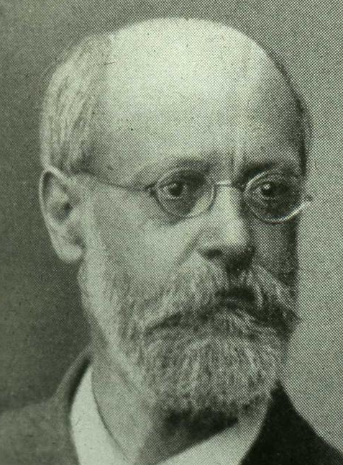

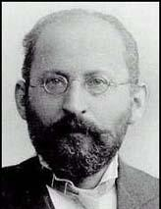
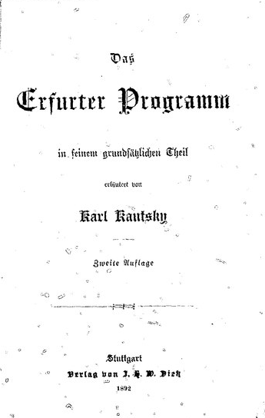

Bernstein and revisionism

Slide 3
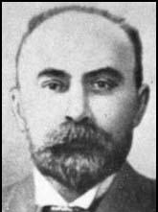
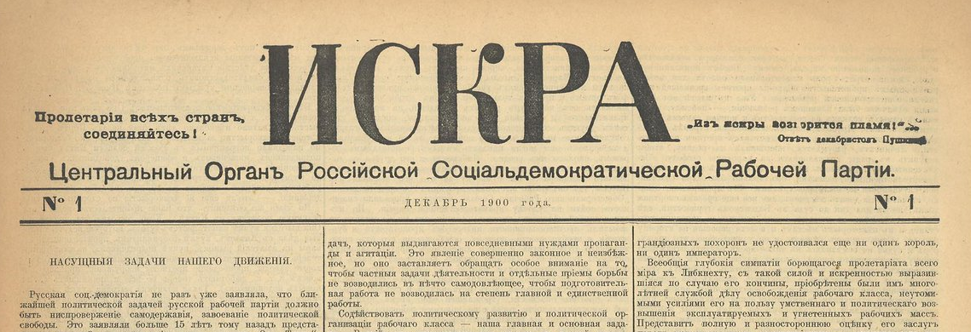
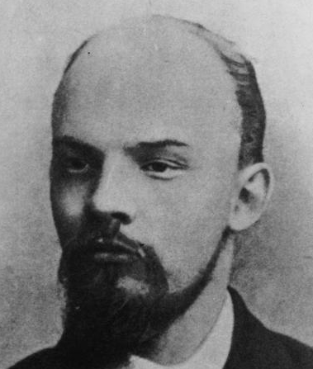
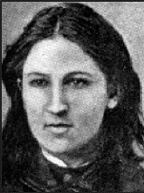
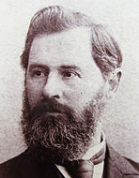
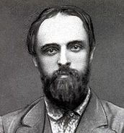
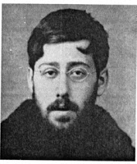
Russian social democracy: Iskra
Georgi Plekhanov
Vera Zasulich
Pavel Axelrod
Alexander Potresov
Iurii Martov
Vladimir Lenin

Slide 4
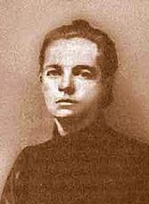
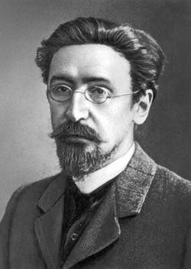

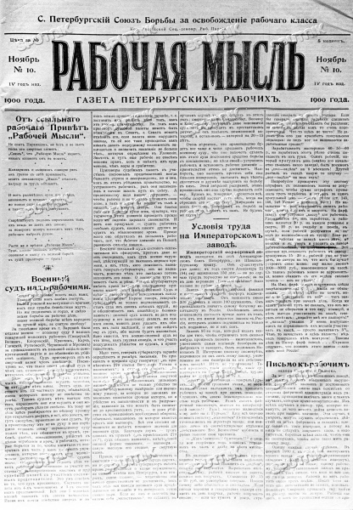
Russian revisionists and Economists
Rabochaia mysl (Rabochaya Mysl)
“the struggle for economic position… is the watchword of the workers movement.”
Ekaterina Kuskova Sergei Prokopovich
“After Belgium I became ashamed to speak of social revolution.”
“Prokopovich… completely agrees with the view of Bernstein.”
“The fundamental law… is that of the line of least resistance.”
Rabochee delo (Rabocheye Dyelo)
“Collection of revisionist articles”
“economic struggles”

Slide 5
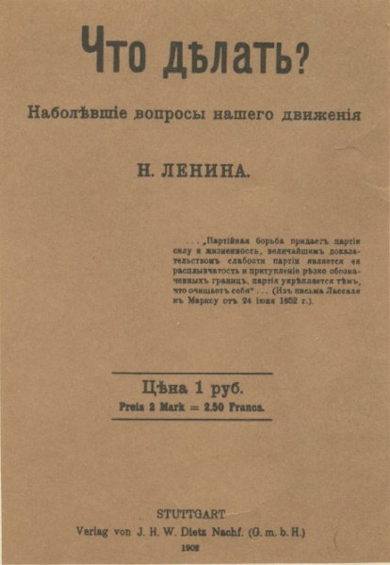
Session 1: Models and adversaries
Key ideas
German SPD model
Revisionism
Russian social democracy c1900
Economism
Questions
1) Why was the German SPD a model for international socialists in the early 20th century?
2) Why was Bernstein a threat?
3) Who are Lenin’s allies and opponents in WITBD?
4) Why do these debates still matter today?

Slide 6
Session 1: Key passages
“Considering, that against this collective power of the propertied classes the working class cannot act, as a class, except by constituting itself into a political party, distinct from, and opposed to, all old parties formed by the propertied classes; That this constitution of the working class into a political party is indispensable in order to insure the triumph of the social revolution and its ultimate end – the abolition of classes…” Marx and Engels (23 September 1871) IWMA London Conference. MECW 22: 427
“The task of Social Democracy is to make the class struggle of the proletariat aware of its aim and capable of choosing the best means to attain this aim.” Kautsky (1892) Das Erfurter Programm.
“I frankly admit that I have extraordinarily little feeling for, or interest in, what is usually termed ‘the final goal of socialism’. This goal, whatever it may be, is nothing to me, the movement is everything.” Bernstein (19 January 1898) The Struggle of Social Democracy and the Social Revolution.
“If Social Democracy could find the courage to emancipate itself from phraseology that is in fact, obsolete and to make up its mind to appear what it is in reality today: a democratic socialist party of reform.” Bernstein (1899) The Preconditions of Socialism, 1993: 186
“He who pronounces himself in favour of the method of legal reforms in place of and as opposed to the conquest of political power and social revolution does not really choose a more tranquil, surer and slower road to the same goal. He chooses a different goal.” Luxemburg, (1899) Social Reform or Revolution. Howard 1971: 115-16
“Social-Democracy in Russia was founded by the Emancipation of Labour group, which was formed abroad in 1883 [by Georgi Plekhanov, Vera Zasulich, Pavel Axelrod…” Lenin (22 April 1914) From the History of the Workers’ Press in Russia. LCW 20: 247-250

