Slide 1
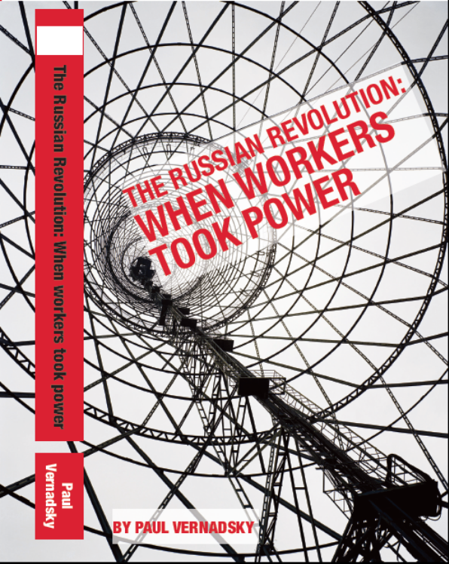

1. Why the Russian revolution?
Greatest example of independent working class politics
Socialist revolution – workers’ self-liberation
Working class political power
Overthrew bourgeois state
International solidarity against capitalism
Consistent democracy
Struggle for ‘volia’ – liberty
Third camp

Slide 2
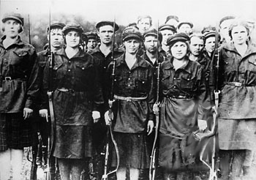
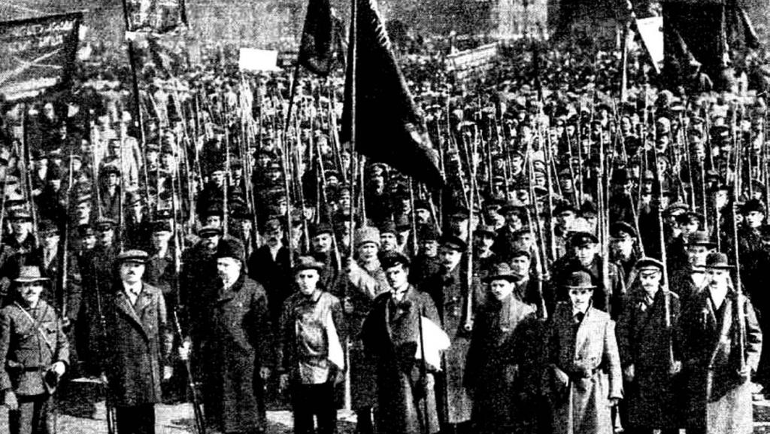
2. What happened in the Russian revolution?
1917
February: tsar overthrown
March: dual power provisional government vs soviets
April: Bolsheviks reorientate
May-June: workers’ control, strikes
July: crackdown
August: Kornilov revolt
September: Bolsheviks win the majority
October: all power to the soviets
November: Bolshevik-led workers’ government

Slide 3
3. Why did the Russian workers’ win?
Key = the working class revolutionary socialist party
1883: Emancipation of Labour Group
1898: RSDLP founded
1900-03: Iskra’s fight with economism
1903: Split Bolsheviks and Mensheviks
1905: Revolution + debate on Duma tactics
1908-11: Ultra-leftism and liquidationism
1912: RSDLP reconstituted by Bolsheviks
1914: First World War
1917: Reorientation for socialist revolution
“There is nothing else that can serve the proletariat as a substitute for its own party… Without a party, apart from a party, over the head of a party, or with a substitute for a party, the proletarian revolution cannot conquer.” Trotsky

Slide 4
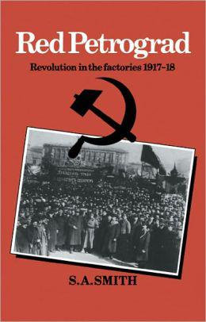
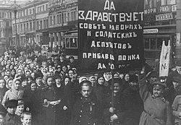
4. How did workers’ organise?
Soviets in 1905
Soviets in 1917
Factory committees
Trade unions
Strikes
Workers’ control

Slide 5
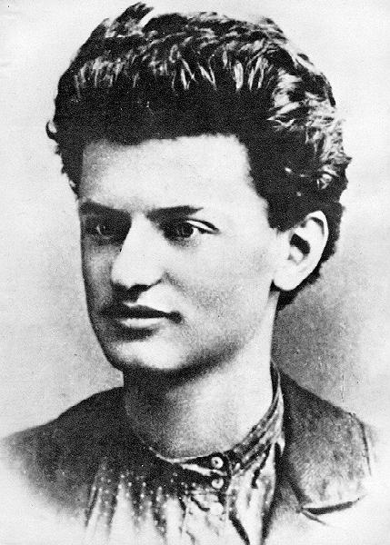
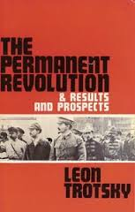
5. What was permanent revolution?
1905 - 1917
Hegemony of the working class in the bourgeois revolution
Workers’ government
Socialist revolution
International interdependence
Uneven and combined development
“the whip of external necessity”
“the privilege of historical backwardness”

Slide 6

6. How to oppose imperialist wars?
Clausewitz: “War is the continuation of politics by other means”
Trotsky: “The objective historical meaning of the war is of decisive importance for the proletariat: What class is conducting it and for the sake of what?”
Lenin’s defeatism:
The special Russian position: defeat of Russia by Germany is the “lesser evil”
The objective statement that “defeat facilitates revolution”
The slogan: wish defeat in every country
Do not halt before the risk of defeat.

Slide 7
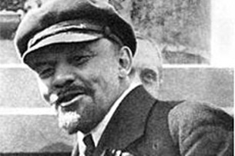

7. How to fight national oppression?
Lenin’s consistent democracy
“Just as socialism cannot be victorious unless it introduces complete democracy, so the proletariat will be unable to prepare for victory over the bourgeoisie unless it wages a many-sided, consistent and revolutionary struggle for democracy”.
“We fight against the privileges and violence of the oppressor nation, and do not in any way condone strivings for privileges on the part of the oppressed nation”.

Slide 8
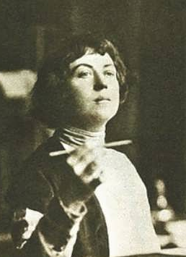
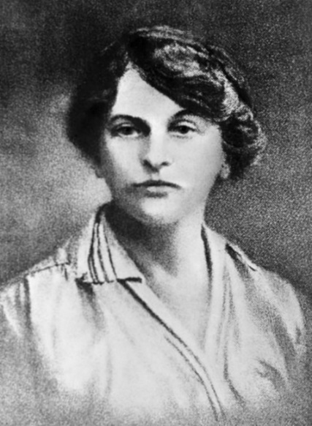
8. How did the Bolsheviks fight for women?
Rabotnitsa (Woman Worker)
Decrees
Party women’s section (zhenotdel)
Communist women conferences
“To become really free woman has to throw off the heavy chains of the current forms of the family, which are outmoded and oppressive. For women, the solution of the family question is no less important than the achievement of political equality and economic independence…
“The sexual act must be seen not as something shameful and sinful but as something which is as natural as the other needs of healthy organism, such as hunger and thirst.” Kollontai

Slide 9

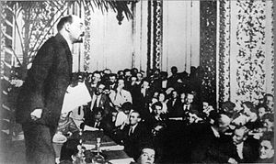
9. What did the Comintern teach?
Assessment
Strategy and tactics
- Trade unions
- Parliament
- Labour Party
Transitional demands
United front
Workers’ government
Anti-racism in the US

Slide 10
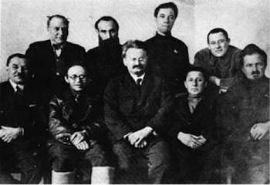

10. Why did it go wrong?
Stalin’s counter-revolution
1921: Ban on factions
1923: The New Course
1926: United Opposition
1928: Defeat of the Left Opposition
1928-29: Stalin’s “revolution from above”: forced
industrialisation and collectivisation
1936: Moscow trials
1940: Murder of Trotsky

