Slide 1
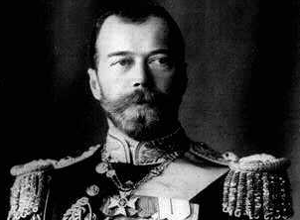
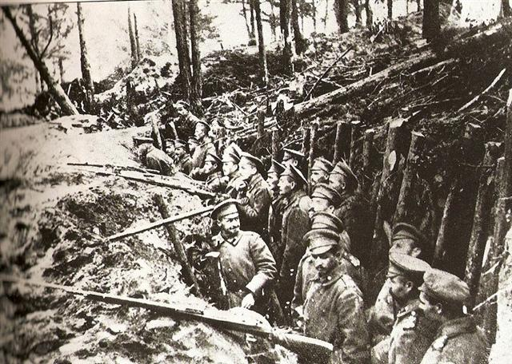
The situation in 1917
Tsarist absolutist state – limited Duma, few liberties, secret police (Okhrana) and Siberian prisons
Capitalist development based on foreign investment
160 million people, one-fifth urbanised
Peasantry – 80% – demand for land
Working class – 18.5 million workers, (3.5 million factories and mines)
Prison house of nations, Russians less than half, 100 ethnicities
The war – 3.6 million dead or seriously wounded
“Everyone knew the country was living on a volcano” Miliukov

Slide 2
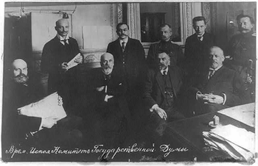
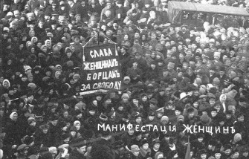
Political forces in 1917
Octobrists: Constitutional monarchist (Guchkov, Rodzianko)
Kadets: liberal (Miliukov)
Progressists: liberal (Efremov, Konovalov)
Socialist Revolutionaries (SRs): peasant
– right (Avksentev); centre (Chernov); left (Spiridonova)
Trudoviks: labour peasant (Kerensky)
RSDLP (Mensheviks):
– right (Chkheidze, Tsereteli); left (Martov)
Mezhraionka: Inter-district committee (Trotsky)
RSDLP (Bolsheviks): (Lenin, Sverdlov, Kamenev)

Slide 3
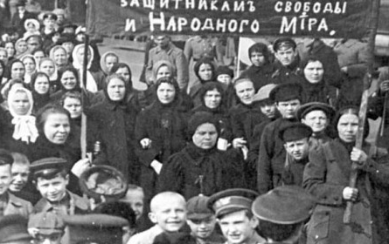
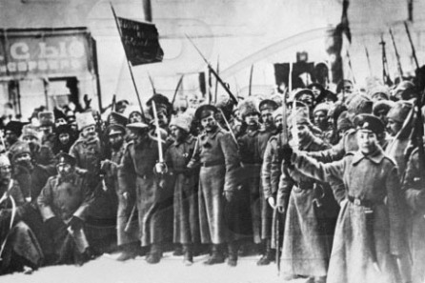
The February revolution
Thursday 23 February: international women’s day – militant women in Petrograd brought out 90,000 workers
Friday 24 February: 200,000 workers come on strike, half the industrial workforce
Saturday 25 February: general strike in Petrograd. Police shoot at protesters and revolutionists arrested
Sunday 26 February: tsar Nicholas dissolved the state Duma and ordered soldiers to suppress the protests
Monday 27 February: Tauride Palace – temporary committee of the state Duma and the Petrograd soviet formed.

Slide 4
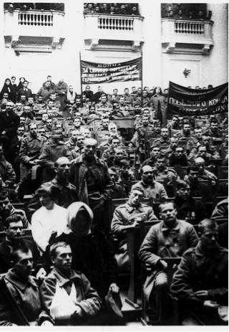
Dual power
The provisional government never a democratically-elected. It was made up of remnants of the old state machine who attempted to restore order and those who wanted to continue the war:
Prince Lvov minister-president
Miliukov minister of foreign affairs
Guchkov minister of war
Konovalov minister of trade
Kerensky minister of justice
400 soviets by March; later 1,400
Soviet Order No.1
Red Guards
Factory committees
Trade unions
Workers’ control

Slide 5
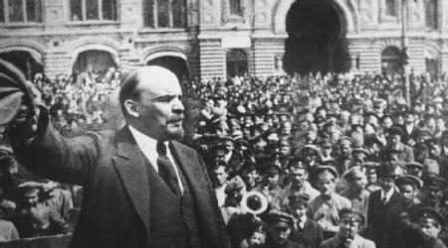
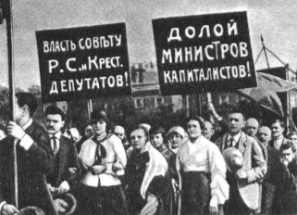
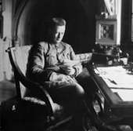
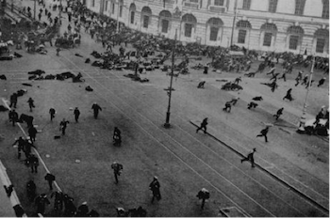
April crises to the July Days
3 April: Lenin’s return
– Bolsheviks reorientate
18 April: Miliukov letter
– government crisis
30 May: Petrograd conference of factory committees
3 June: the first all-Russian congress of workers’ and soldiers’ soviets
13 June: ‘All power to the soviets’
18 June: 400,000 strong demonstration
3-4 July: Half a million demonstrate
5-7 July: Government crackdown; Kerensky premier

Slide 6
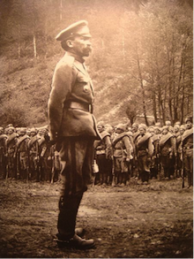
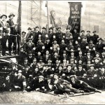
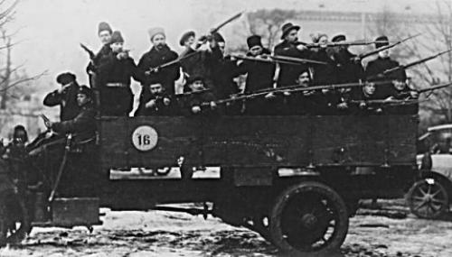
Kornilov revolt
27 August: Kornilov orders troops to occupy Petrograd
28 August: soviet “committee for struggle against the counterrevolution”
29-31 August: Bolsheviks mobilise workers, train Red Guards, agitate among troops, paralyse communications. Coup thwarted.

Slide 7
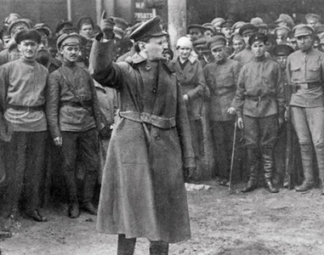
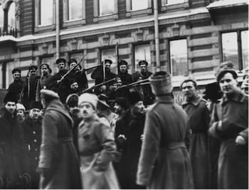
Bolsheviks win a majority for soviet power
26 July: RSDLP sixth congress: 200,000 members in 162 branches
27 August: Ivanovo-Voznesensk Bolsheviks win city Duma elections
30 August: Lazar Bregman elected president of the Kronstadt soviet
31 August: First Bolsheviks majority in the Petrograd soviet
1 September: 126 soviets requested the soviet to take over power
5 September: Bolsheviks win the Moscow soviet
5 September: Krasnoyarsk congress of soviets – Bolshevik majority
6 September: Ekaterinburg – power in hands of soviets
10 September: Finland congress of soviets Bolsheviks triumph
24 September: Moscow Bolsheviks win majority in district elections
25 September: Trotsky chair of Petrograd soviet

Slide 8
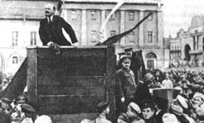
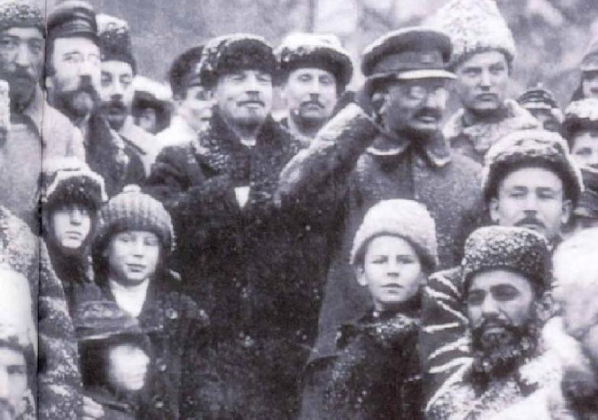
The October revolution
9 October: military revolutionary committee (MRC) conceived
10 October: Bolshevik central committee resolution to lead an armed insurrection was carried by ten votes to two
11-13 October: congress of soviets of the northern region – establishes military committee
16 October: Bolshevik central committee meeting reconvened
20 October: first MRC meeting
21 October: Petersburg garrison acknowledges the soviet as the sole power
23 October: Peter and Paul fortress supports soviet power
23-24 October: Kerensky government attempts to repress Bolsheviks
25 October: seizure of power; second congress of soviets

